Slide 1
Magnetic Modelling (1)
Hall Model
The current MICE Hall Model is complete insomuch as that we are not actively adding new structural components within the hall. The model is being used to gain information about the fields in the racks behind the north shield wall and the compressors on the west wall under various assumptions. (Note to Ken this is mainly about mass distribution within the racks.)
The racks/compressors contain some fairly fine detail and so given the size of the Hall model there is a compromise wrt the achieved meshing resolution.
It is clear that the results that the model is producing needs checking with reality.
Vicky Bayliss is building a finer magnetic model of the setup (including identical compressors) in use in R9 and this will be backed up with real field measurements. We will extrapolate the results of the R9 bench-test to the MICE Hall model as a first indication of the validity of results.

Slide 2
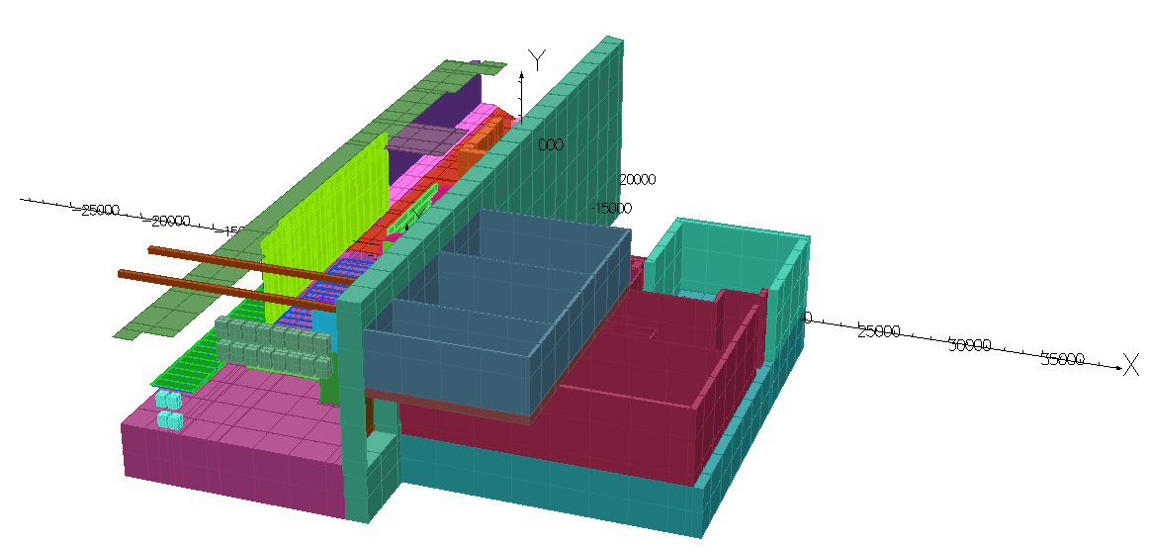
Magnetic Modelling (2)
Insert Hall Picture
Details of all the MICE Hall models and the scripts that built them are kept on a website:
http://www.hep.shef.ac.uk/research/mice/opera_models/test_models.html
The hall model is currently being extended to include all the ‘South Side Buildings’ this is the MLCR, plant room, proposed rack room 2, Hydrogen room and the ISIS control rooms.

Slide 3
Magnetic Modelling (3)
Sub Modelling
It has now been demonstrated (Mike Courthold) that it is possible to transfer a field map from one model to another and run the second model with the transferred field map set as a boundary condition.
This is useful for modelling regions in higher detail/resolution than can be obtained in the Hall model. Given that these volumes would often not include the MICE solenoids then an external field often needs to be applied to these sub models.
Sub modelling also enables us to bring other help onto the modelling project as these sub models can be worked upon independently. We have now an offer of help from Daresbury (Kiril Marinov) and a new RA at Imperial (Melissa George) who is joining the modelling project.
First meeting to get this sub modelling started has been arranged to be held at Daresbury on the 31st January.

