Slide 1

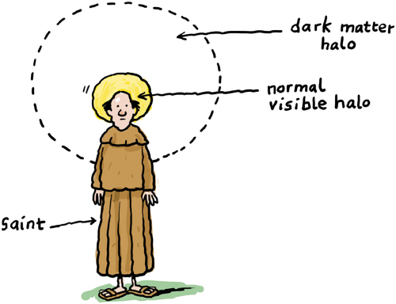
ASTROPARTICLE PHYSICS LECTURE 4
Susan Cartwright
University of Sheffield

Slide 2
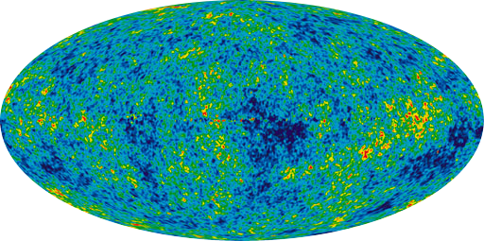
Dark Matter
Astrophysical Evidence
Candidates
Detection

Slide 3
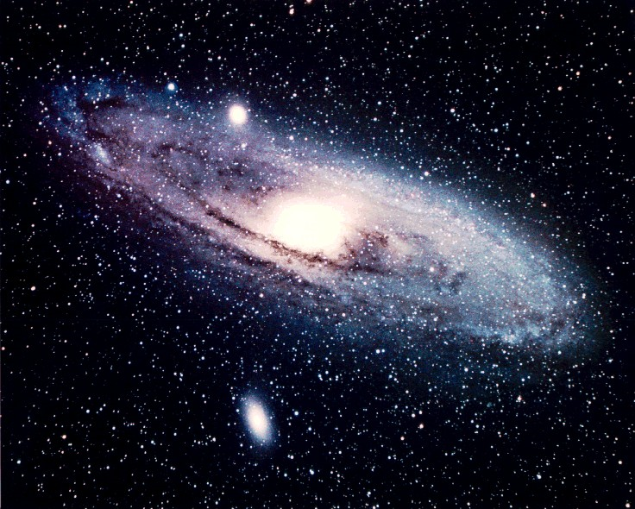
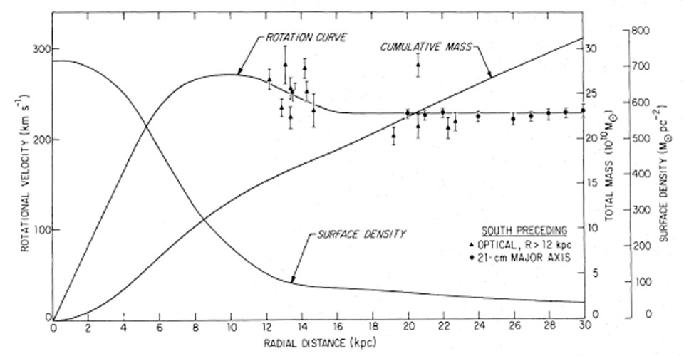
The Astrophysical Evidence
Rotation curves of spiral galaxies
flat at large radii: if mass traced light we would expect them to be Keplerian at large radii, v ∝ r^{−1/2}, because the light is concentrated in the central bulge
and disc light falls off exponentially, not ∝ r⁻² as required for flat rotation curve

Slide 4
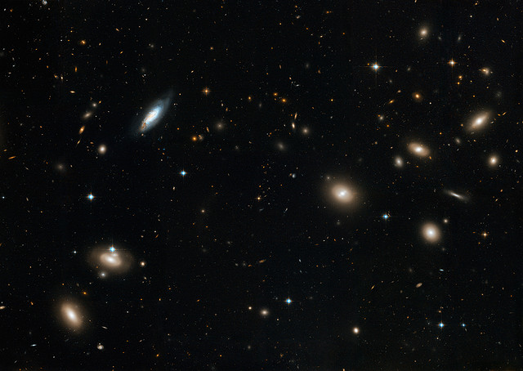
The Astrophysical Evidence
Dynamics of rich clusters
Zwicky (1933!) noted that the velocities of galaxies in the Coma cluster were too high to be consistent with a bound system

Slide 5
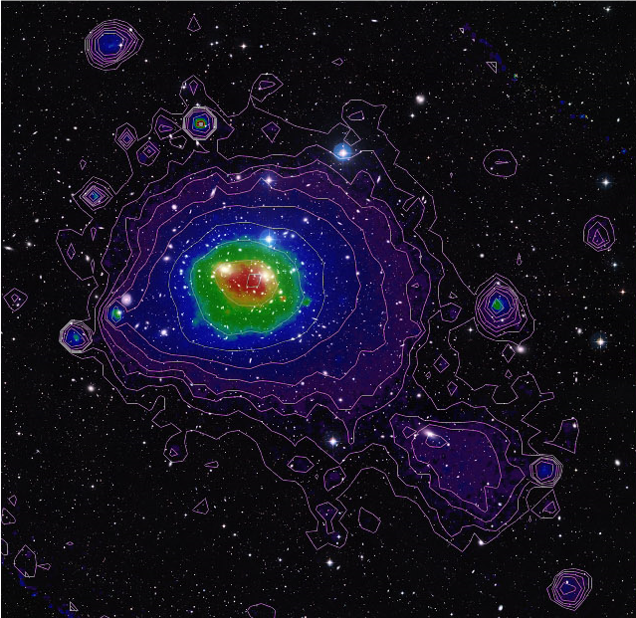
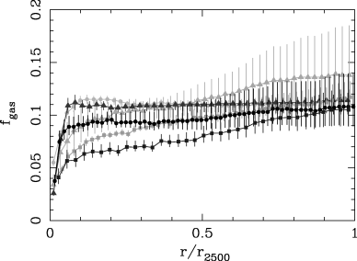
The Astrophysical Evidence
Dynamics of rich clusters
mass of gas and gravitating mass can be extracted from X-ray emission from intracluster medium
ROSAT X-ray image of Coma cluster overlaid on optical.
MPI (ROSAT image); NASA/ESA/DSS2 (visible image)
Allen et al., MNRAS 334 (2002) L11

Slide 6
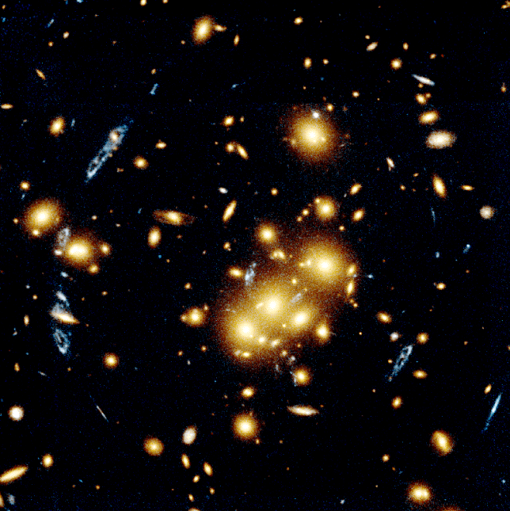
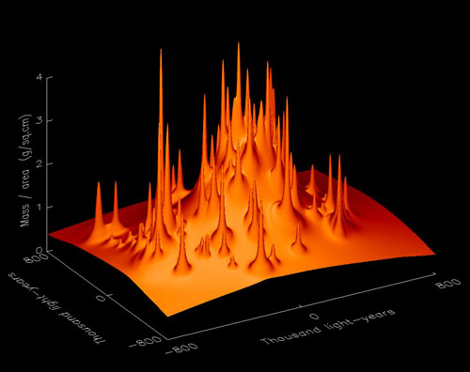
The Astrophysical Evidence
Dynamics of rich clusters
Mass map of CL0024+1654 as determined from the observed gravitational lensing.
Tyson, Kochanski and Dell’Antonio, ApJ 498 (1998) L107

Slide 7
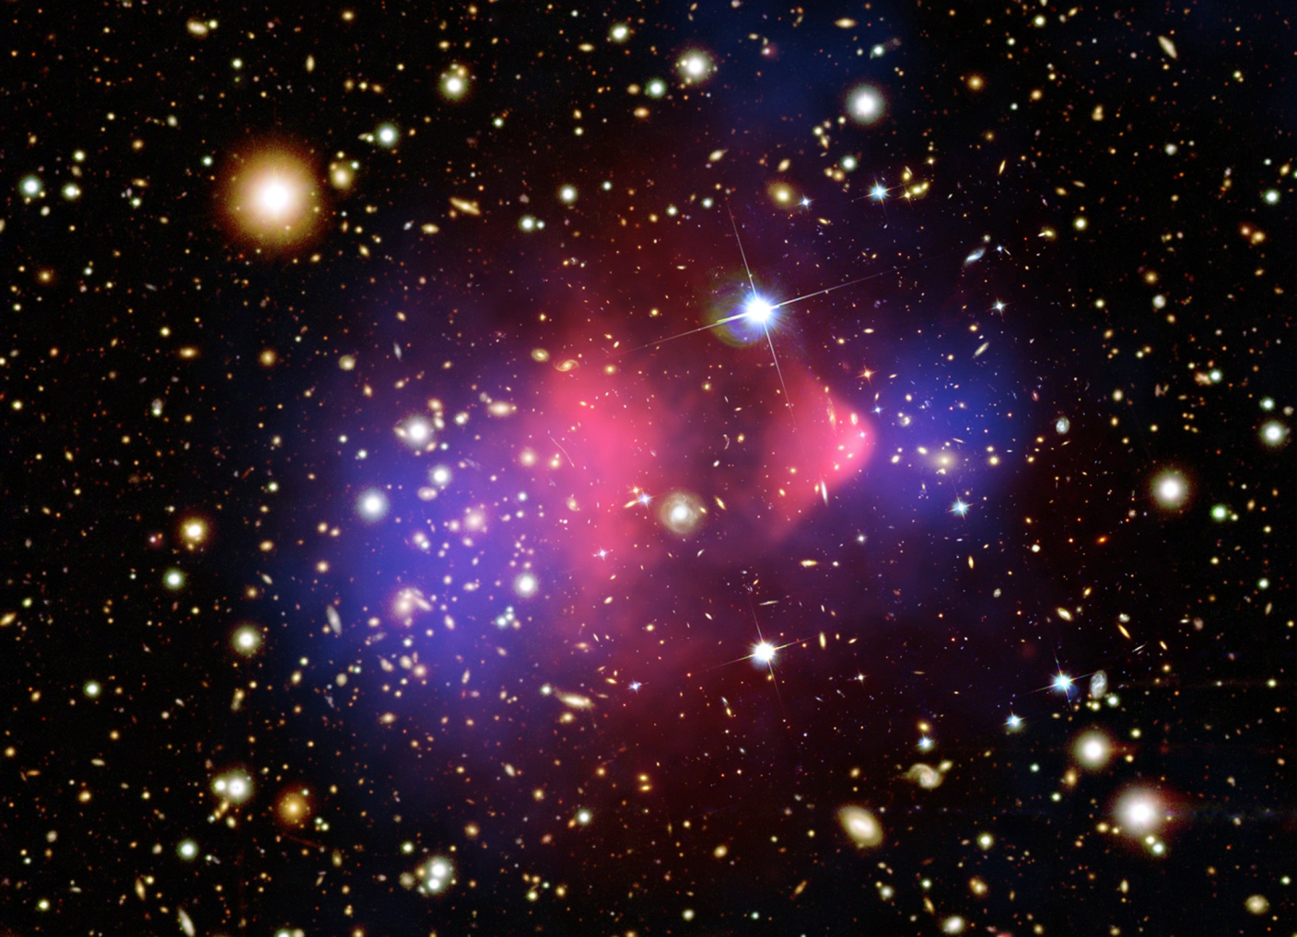
The Astrophysical Evidence: The Bullet Cluster
Mass from lens mapping (blue) follows stars not gas (red)
dark matter is collisionless
Composite Credit: X-ray: NASA/CXC/CfA/ M. Markevitch et al.; Lensing Map: NASA/STScI; ESO WFI; Magellan/U.Arizona/ D.Clowe et al Optical: NASA/STScI; Magellan/U.Arizona/ D.Clowe et al.

Slide 8
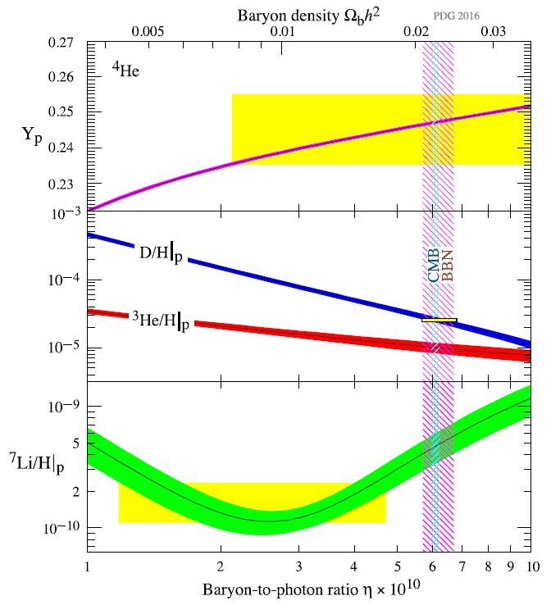
Non-Baryonic Dark Matter
PDG review
Density of baryonic matter strongly constrained by early-universe nucleosynthesis (BBN)
density parameter of order 0.3 as required by data from, e.g., galaxy clusters is completely inconsistent with best fit
“The lithium problem”: possible new physics??

Slide 9
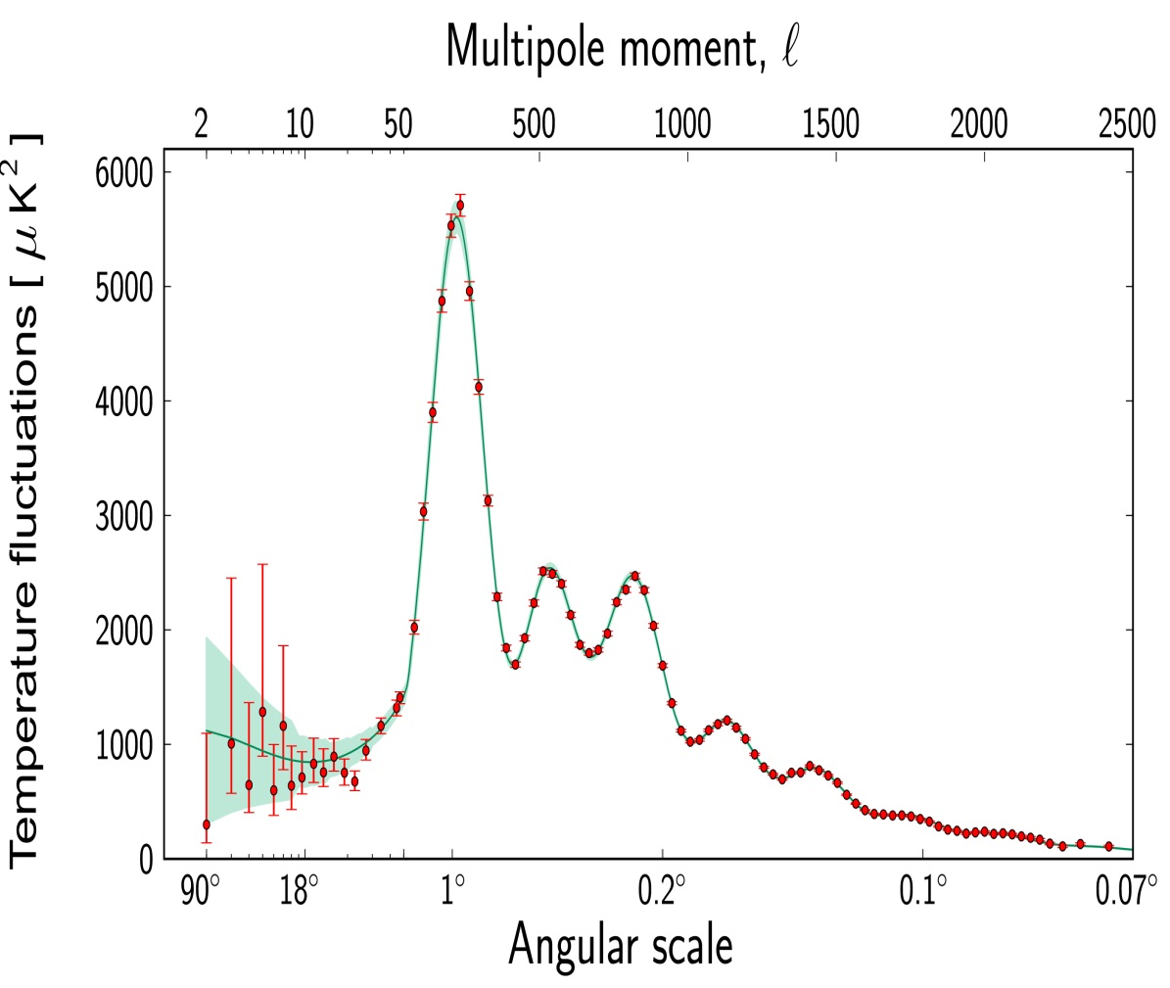
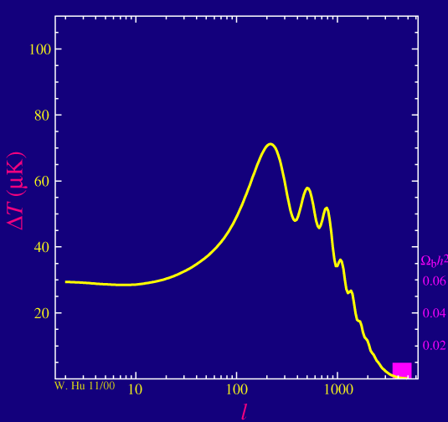
Non-Baryonic Dark Matter: Cosmology
Ratio of odd/even peaks depends on Ω_{b}
Planck
Wayne Hu

Slide 10
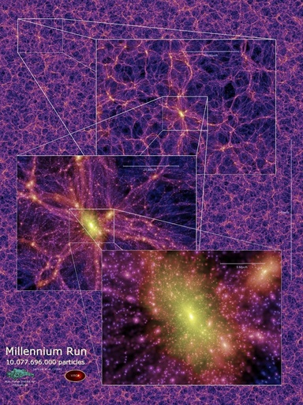
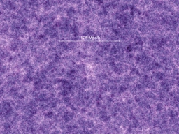
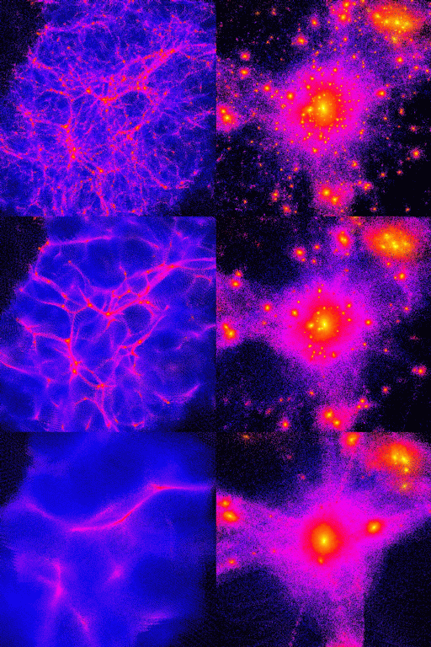
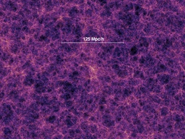
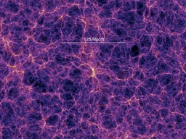
Large Scale Structure
Relativistic (hot) dark matter makes structure top-down—non-relativistic (cold) bottom-up.
Real world looks like cold dark matter.
VIRGO Consortium Millennium Simulation
http://www.mpa-garching.mpg.de/ galform/millennium/

Slide 11
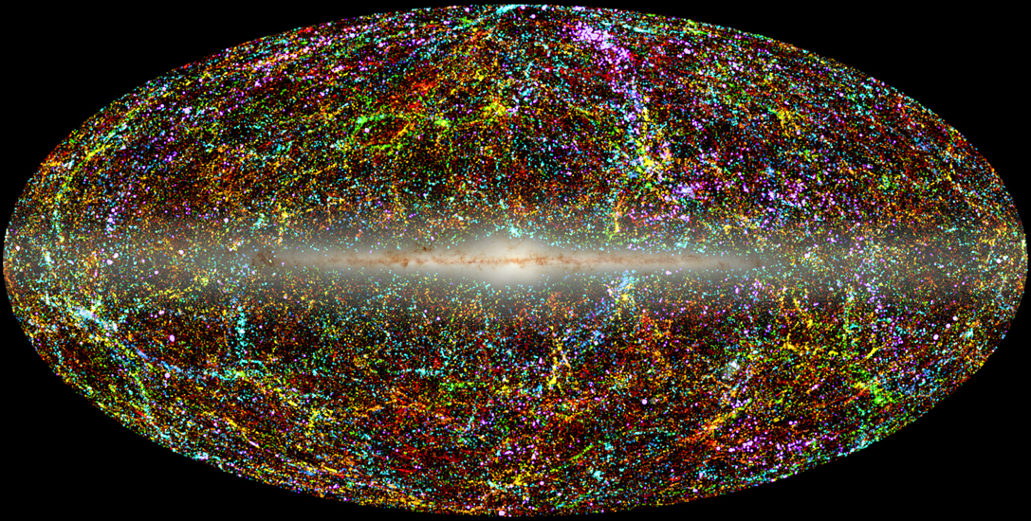
2MASS Galaxy Survey
Local galaxies (z < 0.1; distance coded by colour, from blue to red)
Statistical studies, e.g. correlation functions, confirm visual impression that this looks much more like cold than hot dark matter

Slide 12
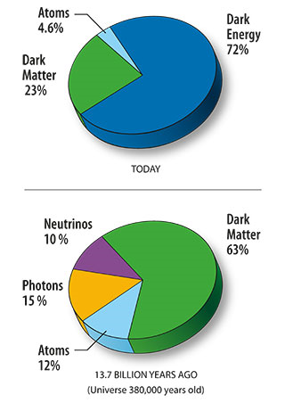
Brief Summary of Astrophysical Evidence
Many observables concur that Ω_{m0} ≈ 0.3
Most of this must be non-baryonic
BBN and CMB concur that baryonic matter contributes Ω_{b0} ≈ 0.05
Bullet Cluster mass distribution indicates that dark matter is collisionless
No Standard Model candidate
neutrinos are too light, and are “hot” (relativistic at decoupling)
hot dark matter does not reproduce observed large-scale structure
BSM physics

Slide 13
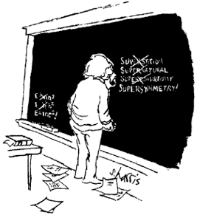
Dark Matter
Astrophysical Evidence
Candidates
Detection

Slide 14
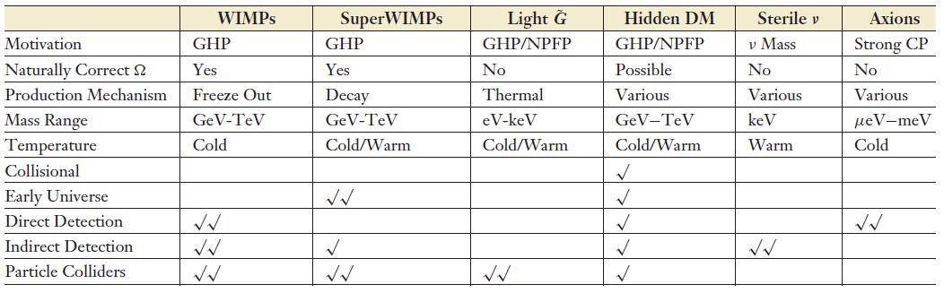
Dark Matter Candidates
GHP = Gauge Hierarchy Problem; NPFP = New Physics Flavour Problem
√ = possible signal; √√ = expected signal
Jonathan Feng, ARAA 48 (2010) 495 (highly recommended)

Slide 15
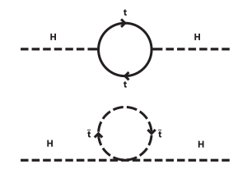
Particle Physics Motivations
Gauge Hierarchy Problem
in SM, loop corrections to Higgs mass give and there is no obvious reason why Λ ≠ M_{Pl}
supersymmetry fixes this by introducing a new set of loop corrections that cancel those from the SM
new physics at TeV scale will also fix it (can set Λ ~ 1 TeV)
New Physics Flavour Problem
we observe conservation or near-conservation of B, L, CP
and do not observe flavour-changing neutral currents
new physics has a nasty tendency to violate these
can require fine-tuning or new discrete symmetries, e.g. R-parity

Slide 16
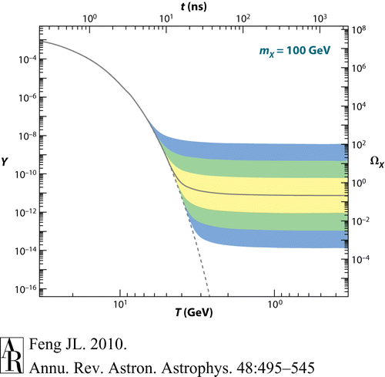
WIMPs
Weakly Interacting Massive Particles
produced thermally in early universe
annihilate as universe cools, but “freeze out” when density drops so low that annihilation no longer occurs with meaningful rate
“target volume” per particle in time Δt is σ_{A}vΔt, where σ_{A} is cross-section
so annihilation rate is n_{f}⟨σ_{A}v⟩ where n_{f} is number density
freeze-out occurs when H ≈ n_{f}⟨σ_{A}v⟩, and in radiation era we have H ∝ T²/M_{Pl} (because ρ ∝ T⁴ and G ∝ 1/M_{Pl}²)
can estimate relic density by considering freeze-out

Slide 17
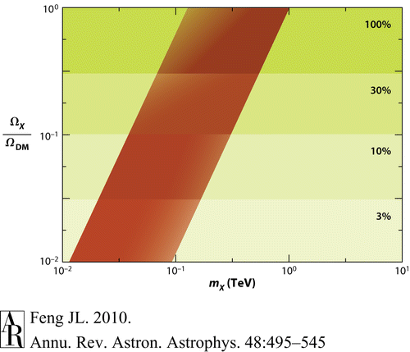
WIMP Relic Density
Converting to Ω gives where x_{f} = m_{X}/T_{f}
and typically ⟨σ_{A}v⟩ ∝ 1/m_{X}² or v²/m_{X}² (S or P wave respectively)
Consequence: weakly interacting massive particles with electroweak-scale masses “naturally” have reasonable relic densities
and therefore make excellent dark matter candidates

Slide 18
Supersymmetric WIMPs
Supersymmetry solves the GHP by introducing cancelling corrections
predicts a complete set of new particles
NPFP often solved by introducing R-parity—new discrete quantum number
then lightest supersymmetric particle is stable
best DM candidate is lightest neutralino (mixed spartner of W⁰, B, H, h)
far too many free parameters in most general supersymmetric models
so usually consider constrained models with simplifying assumptions
most common constrained model: mSUGRA
parameters m₀, M_{1/2}, A₀, tan β, sign(μ)
mSUGRA neutralino is probably the best studied DM candidate

Slide 19
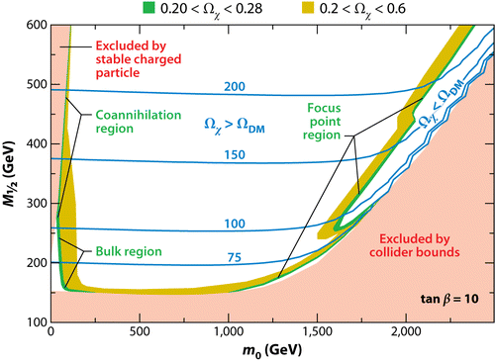
SUSY WIMPs
Neutralinos are Majorana fermions and therefore self-annihilate
Pauli exclusion principle implies that χ₁χ₁ annihilation prefers to go to spin 0 final state
prefers spin 1
therefore annihilation cross-section is suppressed
hence Ω_{χ} tends to be too high
parameter space very constrained by WMAP

Slide 20
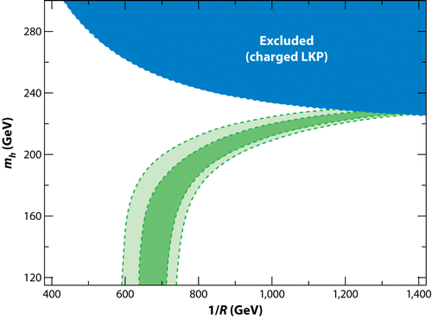
Kaluza-Klein WIMPs
In extra-dimension models, SM particles have partners with the same spin
“tower” of masses separated by R⁻¹, where R is size of compactified extra dimension
new discrete quantum number, K-parity, implies lightest KK particle is stable
this is the potential WIMP candidate
usually B¹
annihilation not spin-suppressed (it’s a boson), so preferred mass higher
Ω_{K} = 0.16−0.24 0.18−0.22

Slide 21
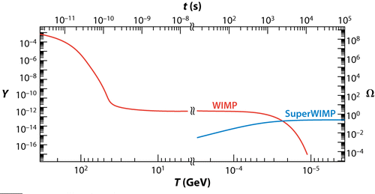
SuperWIMPs
Massive particles with superweak interactions
produced by decay of metastable WIMP
because this decay is superweak, lifetime is very long (10³−10⁷ s)
WIMP may be neutralino, but could be charged particle
dramatic signature at LHC (stable supermassive particle)
candidates:
weak-scale gravitino
axino
equivalent states in KK theories
these particles cannot be directly detected, but indirect-detection searches and colliders may see them
they may also have detectable astrophysical signatures

Slide 22
Light Gravitinos
Expected in gauge-mediated supersymmetry breaking
in these models gravitino has m < 1 GeV
neutralinos decay through γG̃, so cannot be dark matter
gravitinos themselves are possible DM candidates
but tend to be too light, i.e. too warm, or too abundant
relic density in minimal scenario is Ω_{G̃} ≈ 0.25 m_{G̃}/(100 eV)
so require m_{G̃} < 100 eV for appropriate relic density
but require m_{G̃} > 2 keV for appropriate large-scale structure
models which avoid these problems look contrived

Slide 23
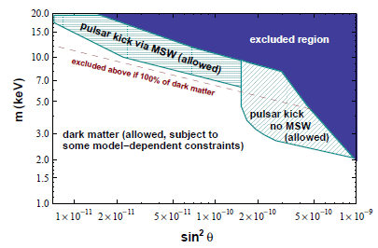
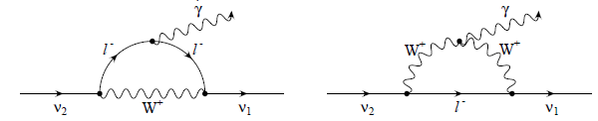
Sterile Neutrinos
Kusenko, DM10
Seesaw mechanism for generating small ν_{L} masses implies existence of massive right-handed sterile states
usually assumed that M_{R} ≈ M_{GUT}, in which case sterile neutrinos are not viable dark matter candidates
but smaller Yukawa couplings can combine with smaller M_{R} to produce observed ν_{L} properties together with sterile neutrino at keV mass scale—viable dark matter candidate
such a sterile neutrino could also explain observed high velocities of pulsars (asymmetry in supernova explosion generating “kick”)
these neutrinos are not entirely stable: τ >> 1/H₀, but they do decay and can generate X-rays via loop diagrams—therefore potentially detectable by, e.g., Chandra

Slide 24
Sterile Neutrinos
Production mechanisms
oscillation at T ≈ 100 MeV
Ω_{ν} ∝ sin² 2θ m^{1.8} from numerical studies
always present: requires small mass and very small mixing angle
not theoretically motivated: some fine tuning therefore required
resonant neutrino oscillations
if universe has significant lepton number asymmetry, L > 0
decays of heavy particles
e.g. singlet Higgs driving sterile neutrino mass term
Observational constraints
X-ray background
presence of small-scale structure
sterile neutrinos are “warm dark matter” with Mpc free-streaming

Slide 25
Axions
Introduced to solve the “strong CP problem”
SM Lagrangian includes CP-violating term which should contribute to, e.g., neutron electric dipole moment
neutron doesn’t appear to have an EDM (<3×10⁻²⁶ e cm, cf. naïve expectation of 10⁻¹⁶) so this term is strongly suppressed
introduce new pseudoscalar field to kill this term (Peccei-Quinn mechanism)
result is an associated pseudoscalar boson, the axion
Axions are extremely light (<10 meV), but are cold dark matter
not produced thermally, but via phase transition in very early universe
if this occurs before inflation, visible universe is all in single domain
if after inflation, there are many domains, and topological defects such as axion domain walls and axionic strings may occur

Slide 26
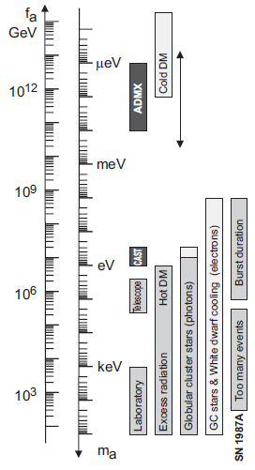
Axions
Axion mass is m_{a} ≈ 6 μeV × f_{a}/(10¹² GeV) where f_{a} is the unknown mass scale of the PQ mechanism
Calculated relic density is Ω_{a} ≈ 0.4 θ² (f_{a}/10¹² GeV)^{1.18} where θ is initial vacuum misalignment
so need f_{a} < 10¹² GeV to avoid overclosing universe
astrophysical constraints require f_{a} > 10⁹ GeV
therefore 6 μeV < m_{a} < 6 meV
Georg Raffelt, hep-ph/0611350v1

Slide 27
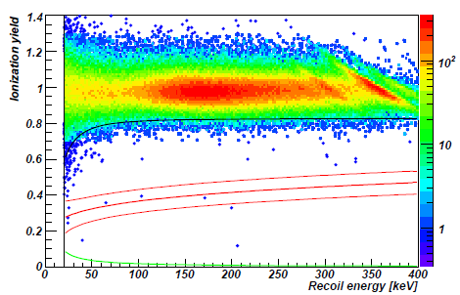
Dark Matter
Astrophysical Evidence
Candidates
Detection

Slide 28
Detection of Dark Matter Candidates
Direct detection
dark matter particle interacts in your detector and you observe it
Indirect detection
you detect its decay/annihilation products or other associated phenomena
Collider phenomenology
it can be produced at, say, LHC and has a detectable signature
Cosmology
it has a noticeable and characteristic impact on BBN or CMB
Focus here on best studied candidates—WIMPs and axions

Slide 29
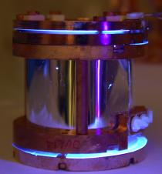
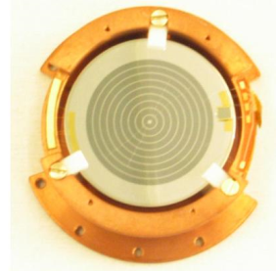
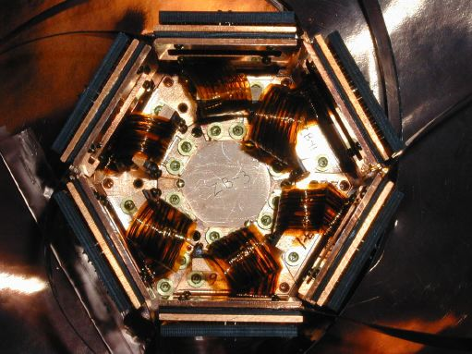
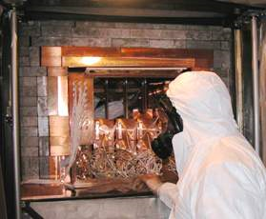
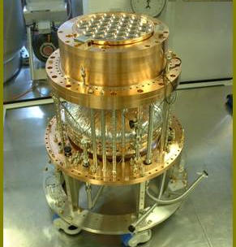
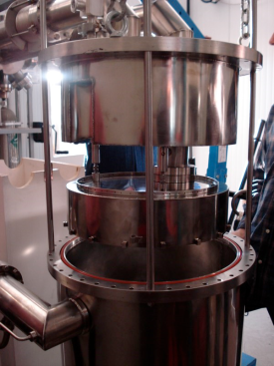
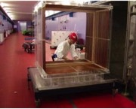
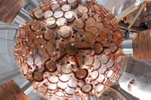
Direct Detection of WIMPS
Basic principle: WIMP scatters elastically from nucleus; experiment detects nuclear recoil
HEAT
CRESST-II
EDELWEISS
CDMS
DAMA/LIBRA
SCINTILLATION IONISATION
DRIFT
XMASS
ZEPLIN III XENON-100

Slide 30
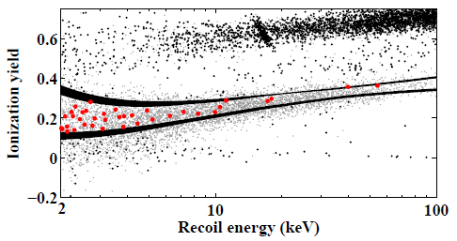
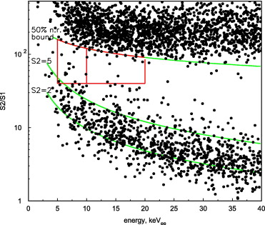
Direct Detection of WIMPS
Backgrounds
cosmics and radioactive nuclei (especially radon)
use deep site and radiopure materials
use discriminators to separate signal and background
Time variation
expect annual variation caused by Earth’s and Sun’s orbital motion
small effect, ~7%
basis of claimed signal by DAMA experiment
much stronger diurnal variation caused by changing orientation of Earth
“smoking gun”, but requires directional detector
current directional detector, DRIFT, has rather small target mass (being gaseous)—hence not at leading edge of sensitivity
CDMS-II, PRL 106 (2011) 131302
ZEPLIN-II, Astropart. Phys. 28 (2007) 287

Slide 31
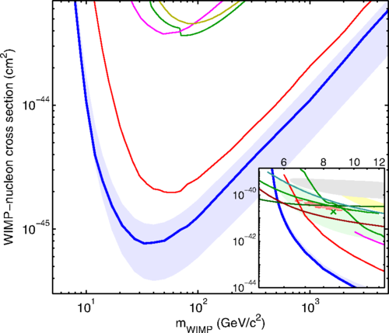
Direct Detection of WIMPs
Signals in inset:
CoGeNT; CDMS; CRESST; DAMA/LIBRA
Spin-indep’t
Interaction with nuclei can be spin-independent or spin-dependent
spin-dependent interactions require nucleus with net spin
most direct detection experi- ments focus on SI, and limits are much better in this case
Some claimed signals at low mass inconsistent with others’ limits
requires very low mass and high cross-section
if real, may point to a non-supersymmetric DM candidate
Edelweiss
CDMS
ZEPLIN
XENON-100
LUX
Akerib et al., PRL 112 091303
DMTools (Butler/Desai)

Slide 32
Indirect Detection of WIMPs
After freeze-out, neutralino self-annihilation is negligible in universe at large
but neutralinos can be captured by repeated scattering in massive bodies, e.g. Sun, and this will produce a significant annihilation rate
number of captured neutralinos N = C – AN² where C is capture rate and A is ⟨σ_{A}v ⟩ per volume
if steady state reached, annihilation rate is just C/2, therefore determined by scattering cross-section
annihilation channels include W⁺W⁻, bb̄, τ⁺τ⁻, etc. which produce secondary neutrinos
these escape the massive object and are detectable by neutrino telescopes

Slide 33
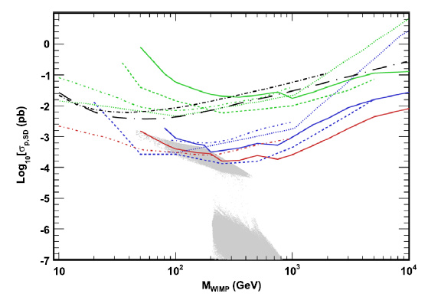
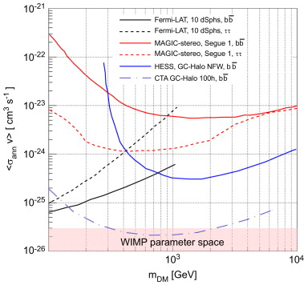
Indirect Detection of WIMPs
— ANTARES; ··· Super-K; --- IceCube
(b̄b; WW; ττ)
−·−· SIMPLE; —·— COUPP
Relatively high threshold of neutrino telescopes implies greater sensitivity to “hard” neutrinos, e.g. from WW
Also possible that neutralinos might collect near Galactic centre
Doro, NIMPA 742 (2014) 99
Spin-dependent
Zornoza & Lambard, NIMPA 742 (2014) 173
in this region other annihilation products, e.g. γ-rays, could escape
Limits from Fermi-LAT, MAGIC, H.E.S.S. not yet reaching expected signal, but CTA could come close

Slide 34
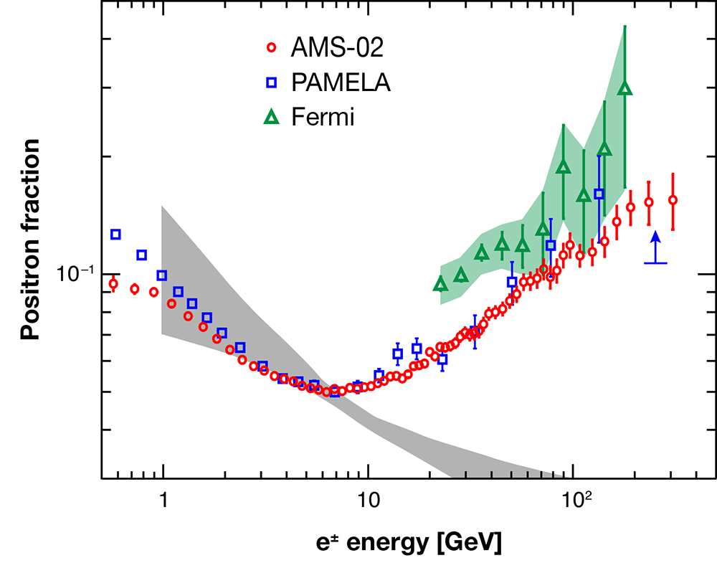
Indirect Detection of WIMPs
Coutu, Physics 6 (2013) 40
Various experiments see positron fraction in cosmic rays rising with energy (unexpectedly)
This could be a signal of χχ annihilation
But there are also potential astrophysical sources, e.g. pulsar wind nebulae, microquasars
And there are no signals for γ-ray excess, which we might expect

Slide 35
LHC Detection of WIMPs and SWIMPs
WIMPs show up at LHC through missing-energy signature
note: not immediate proof of dark-matter status
long-lived but not stable neutral particle would have this signature but would not be DM candidate
need to constrain properties enough to calculate expected relic density if particle is stable, then check consistency
SuperWIMP parents could also be detected
if charged these would be spectacular, because of extremely long lifetime
very heavy particle exits detector without decaying
if seen, could in principle be trapped in external water tanks, or even dug out of cavern walls (Feng: “new meaning to the phrase ‘data mining’”)
if neutral, hard to tell from WIMP proper
but mismatch in relic density, or conflict with direct detection, possible clues

Slide 36
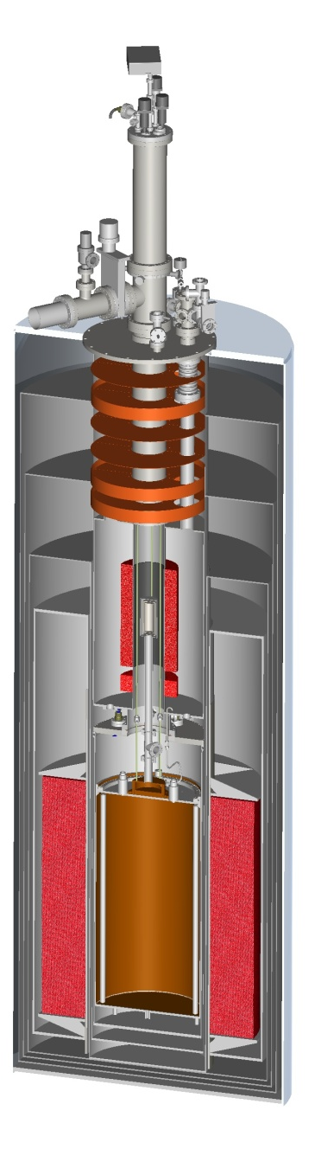
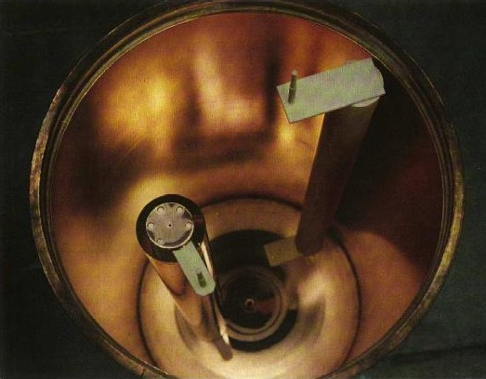
Axion Detection
γ
a
Axions couple (unenthusiastically) to photons via L_{aγγ} = −g_{aγγ}a E∙B
they can therefore be detected using Primakoff effect (resonant conversion of axion to photon in magnetic field)
ADMX experiment uses very high Q resonant cavity in superconducting magnet to look for excess power
this is a scanning experiment: need to adjust resonant frequency to “see” specific mass (very tedious)
alternative: look for axions produced in Sun (CAST)
non-scanning, but less sensitive

Slide 37
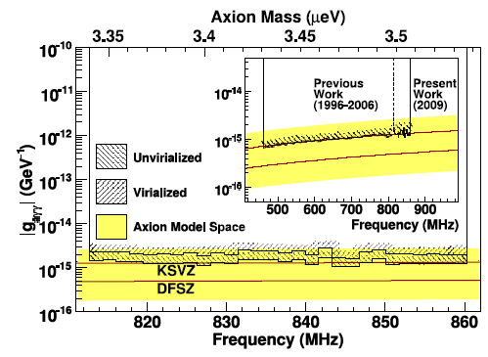
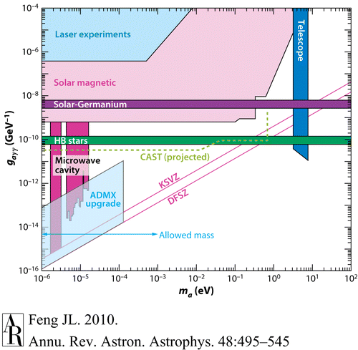

Axion Detection

Slide 38
Dark Matter: Summary
Astrophysical evidence for dark matter is consistent and compelling
not an unfalsifiable theory—for example, severe conflict between BBN and WMAP on Ω_{b} might have scuppered it
Particle physics candidates are many and varied
and in many cases are not ad hoc inventions, but have strong independent motivation from within particle physics
Unambiguous detection is possible for several candidates, but will need careful confirmation
interdisciplinary approaches combining direct detection, indirect detection, conventional high-energy physics and astrophysics may well be required

Slide 39
THE END

