Slide 1
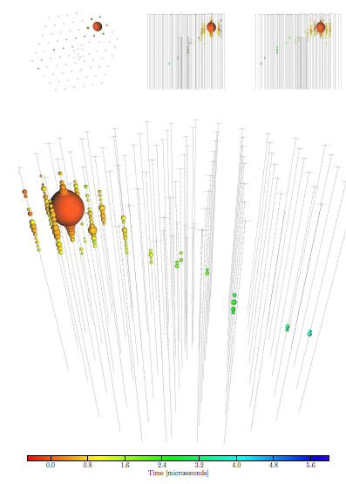

ASTROPARTICLE PHYSICS LECTURE 3
Susan Cartwright
University of Sheffield

Slide 2
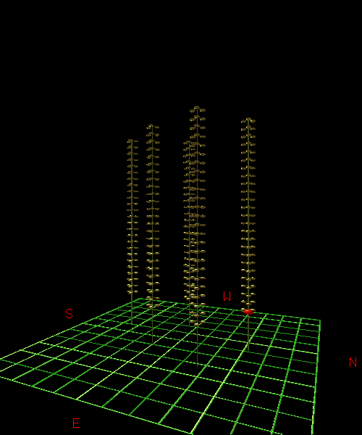
High Energy Astroparticle Physics
Acceleration Mechanisms
Sources
Detection

Slide 3
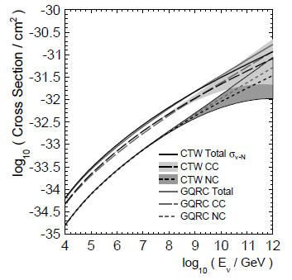
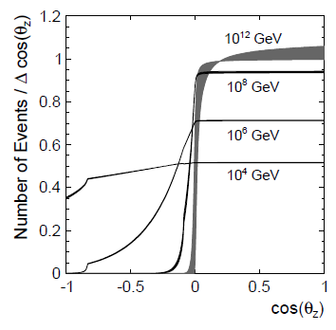
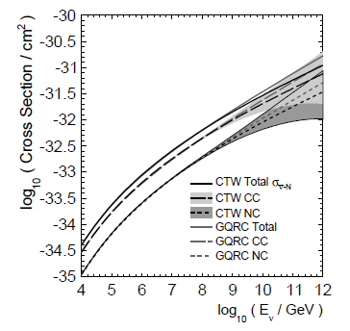
Neutrino Detection
ν
Neutrino cross-section rises with energy
Only UHE neutrinos (>10¹⁵ eV or so) interact with reasonably high probability (such that Earth is opaque to them)
Connolly, Thorne & Waters, hep-ph/1102.0691v1
ν

Slide 4
Neutrino Detection (Penetrating Neutrinos)
Mostly rely on detecting the charged lepton produced in CC interactions
at lowest energies (solar neutrinos), also elastic scattering (ν + e → ν + e) and NC reaction on deuterium (ν + d → ν + p + n)
note that at solar neutrino energies μ and τ cannot be produced by CC, so ν_{μ}, ν_{τ} only seen in NC (e.g. SNO)
Some early experiments using tracking calorimeters, but water Cherenkovs now standard practice
can obtain large effective volumes by instrumenting natural bodies of water/ice
particle identification by ring morphology at low energies, shower shape at high energies

Slide 5
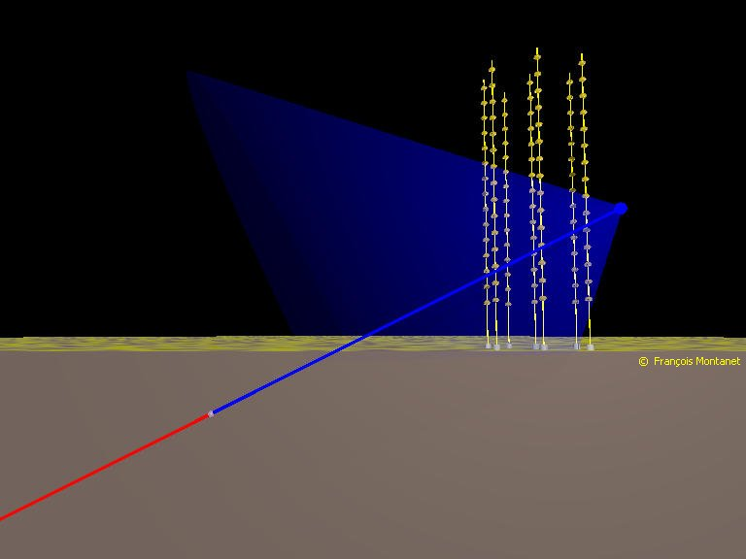
Neutrino Detection by Water Cherenkov
Transparent medium (water/ice)
PMTs
Cherenkov light
μ
CC interaction
Effective volume increases with energy
ν_{μ}

Slide 6
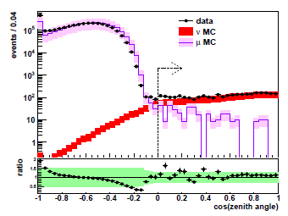
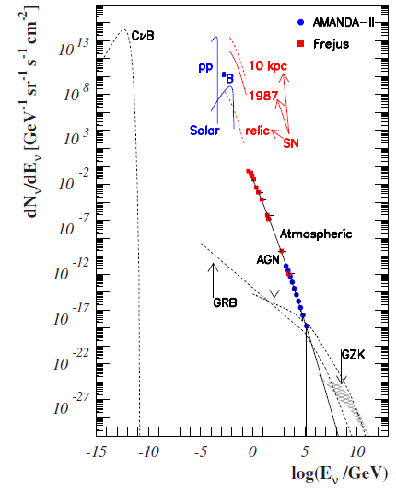
Backgrounds
Cosmic ray muons
Go deep
Look down
therefore, northern hemisphere telescope sees southern sky, and vice versa
Atmospheric neutrinos
one man’s signal is another’s background!
irreducible, but steeper spectrum than high-energy astrophysical neutrinos

Slide 7
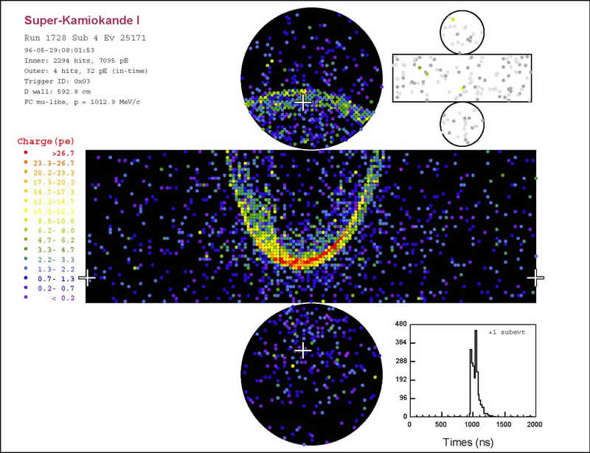
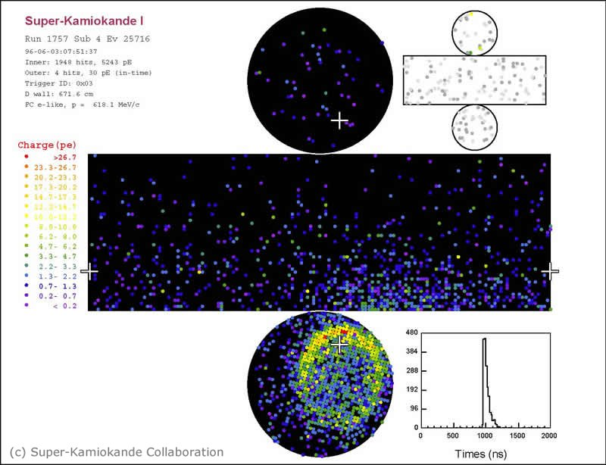
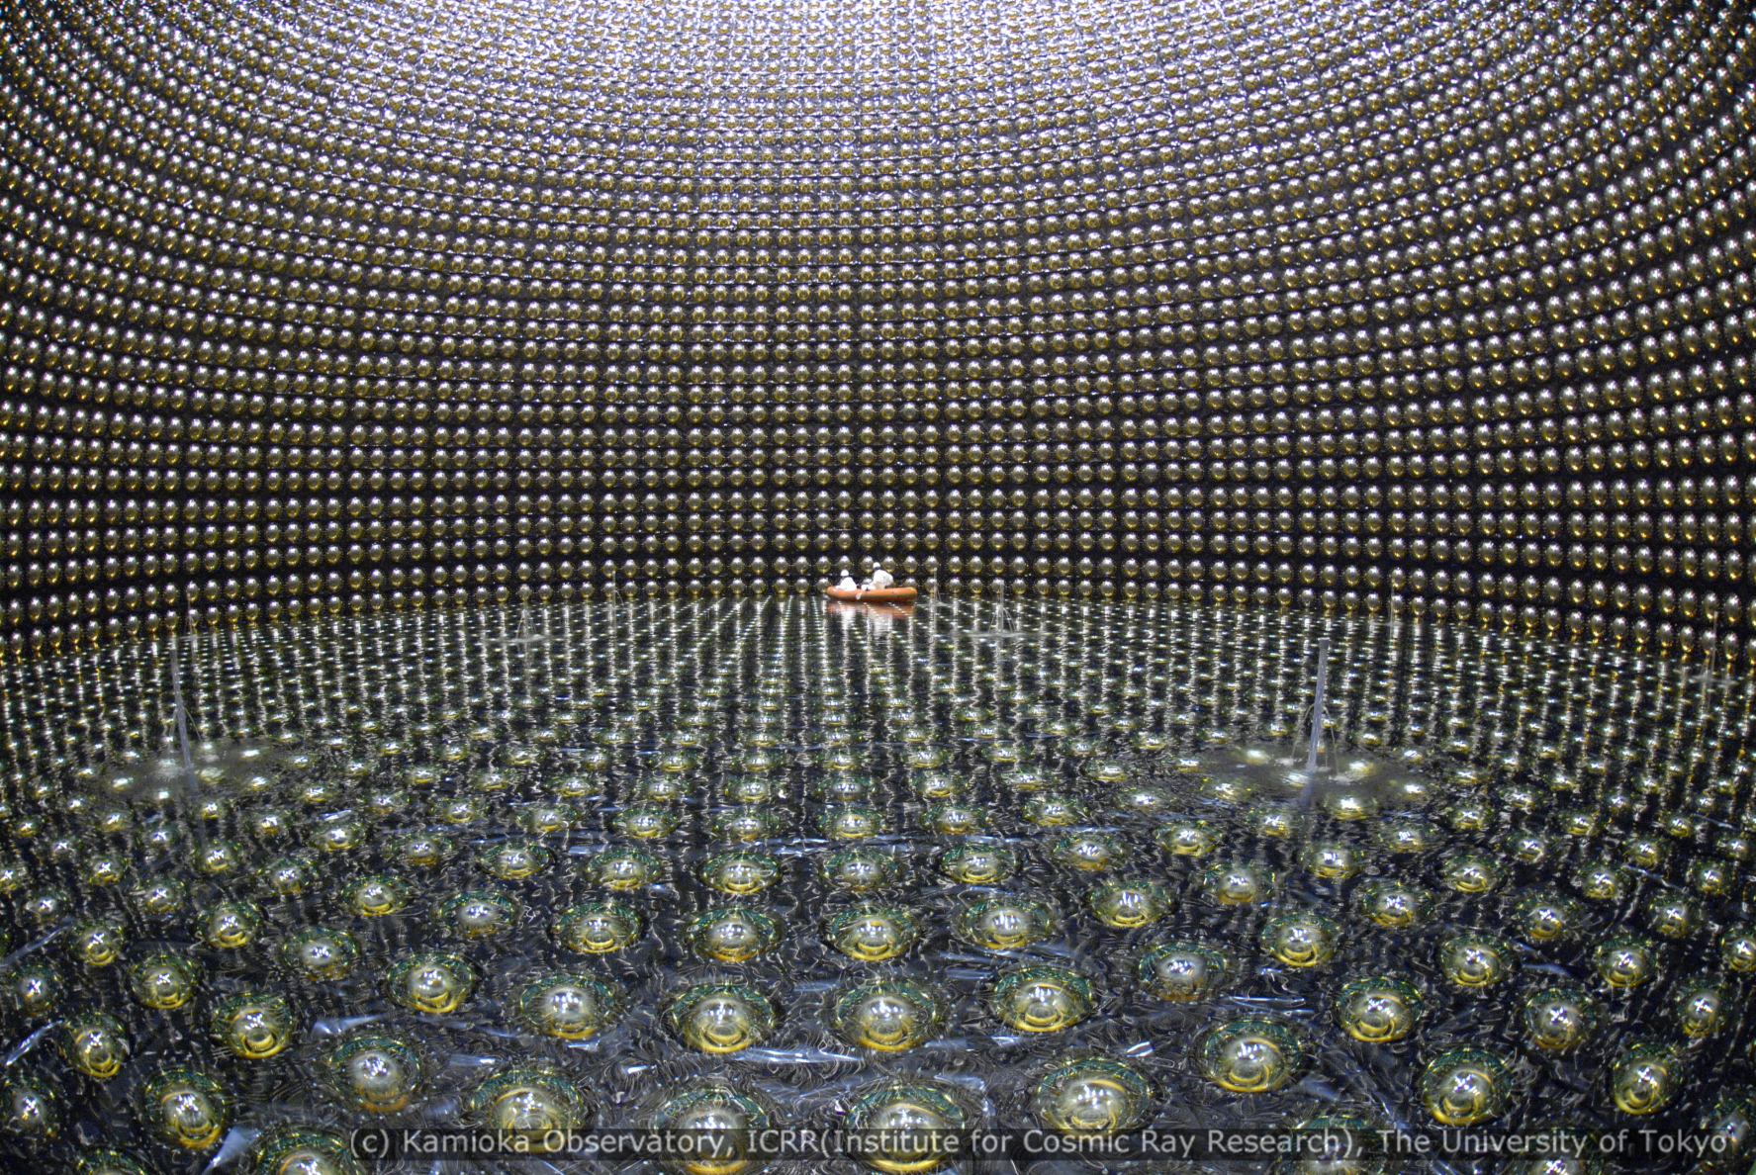
Particle ID: Super-Kamiokande
muon: sharp ring
electron: fuzzy ring

Slide 8
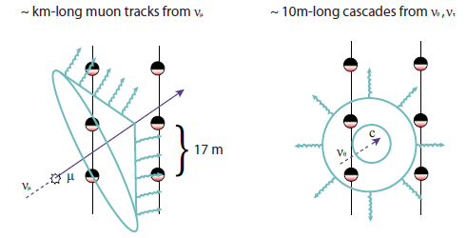
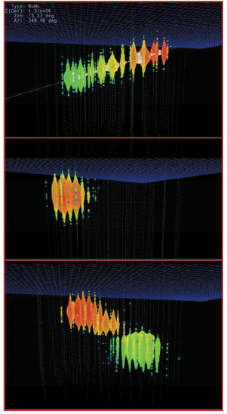
Particle ID: IceCube
ν_{μ}
ν_{e}
“double-bang” ν_{τ} event: initial signal from CC interaction, later one from τ decay
ν_{τ}
Halzen & Klein, Rev. Sci. Inst. 81 (2010) 081101

Slide 9
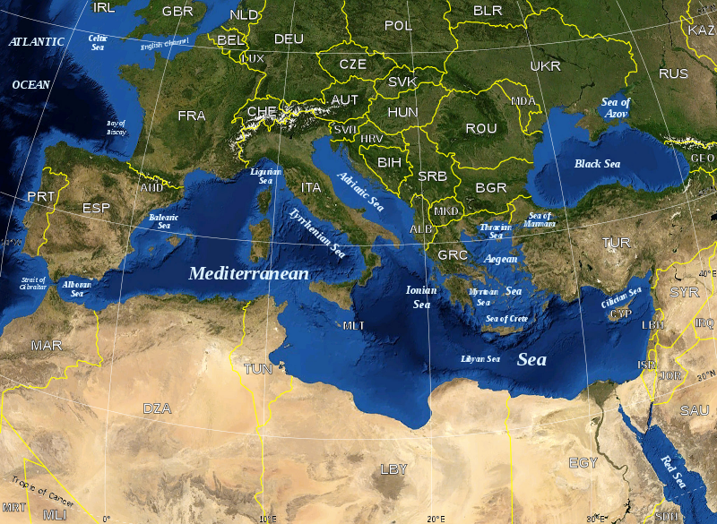

High-Energy Neutrino Telescopes

Slide 10
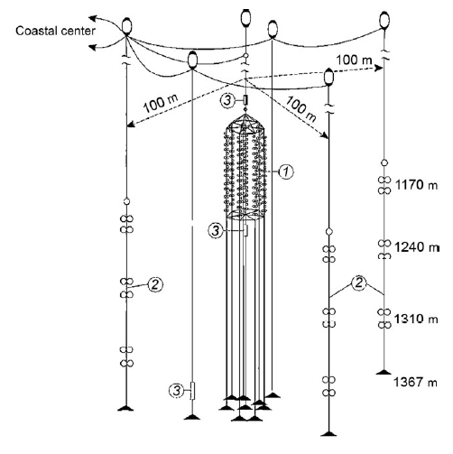
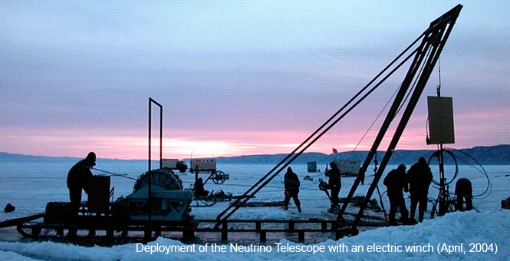
Lake Baikal
Central core (NT200) with 96 pairs of OMs on 8 strings
Outer ring with 3 additional strings each equipped with 6 OM pairs
Lasers for calibration
Each OM equipped with 37-cm PMT

Slide 11
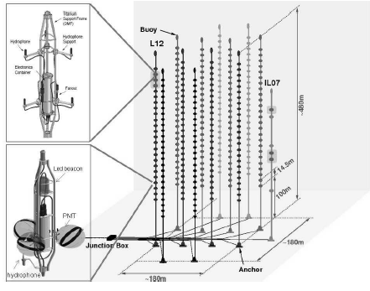
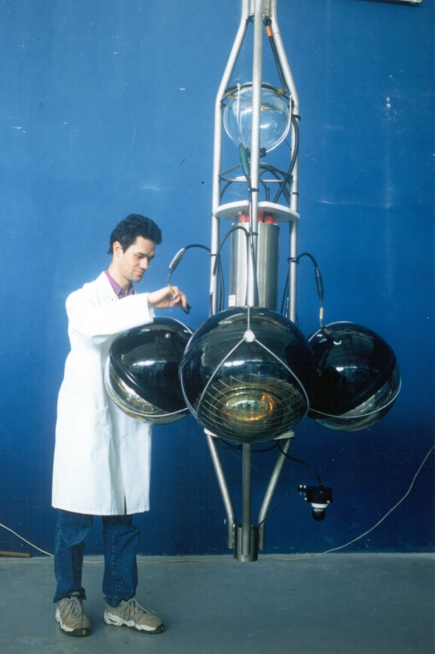
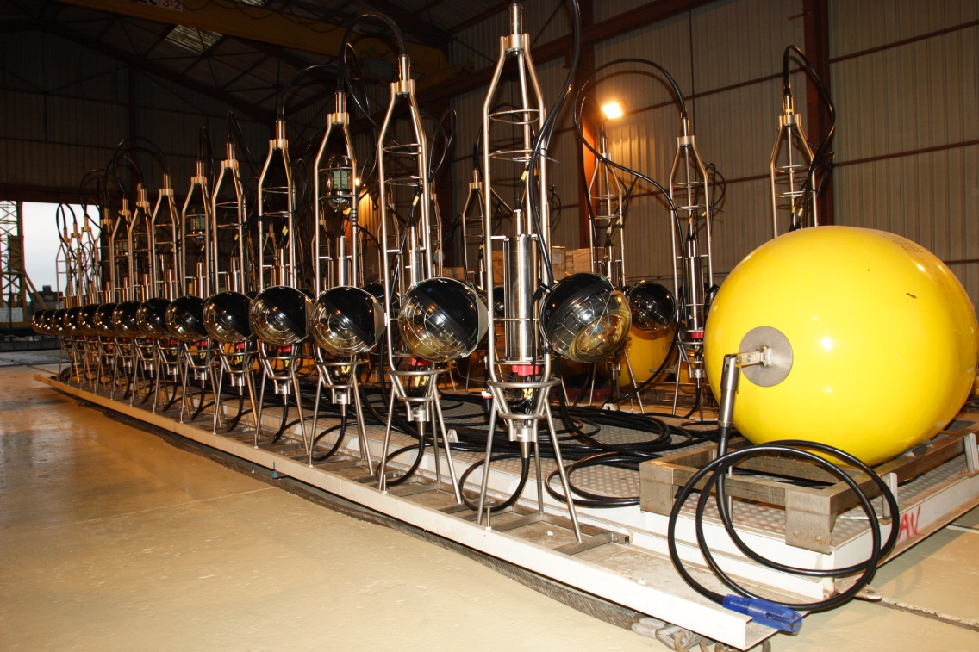
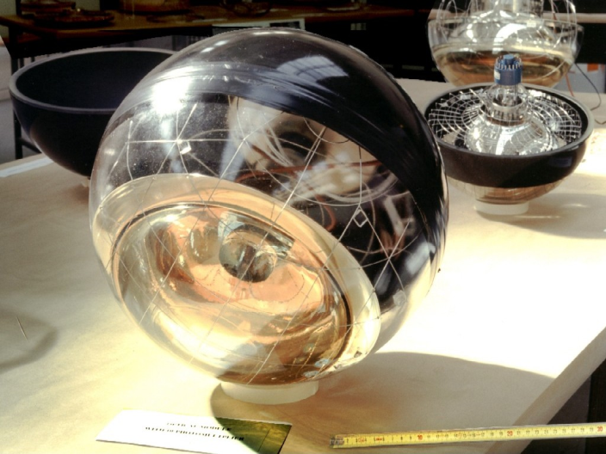
ANTARES
2475 m deep, 42 km off Toulon
885 OMs arranged in triplets on 12 lines; each OM equipped with 10” PMT
Acoustic transponders for position monitoring
LED and laser optical beacons for calibration

Slide 12
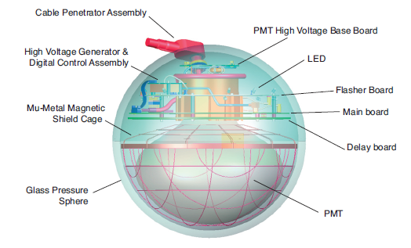
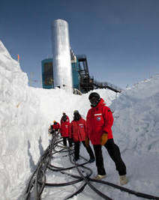
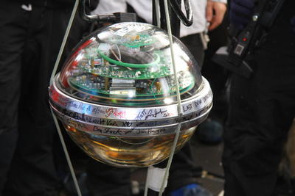
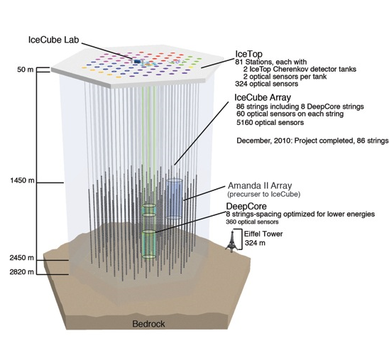
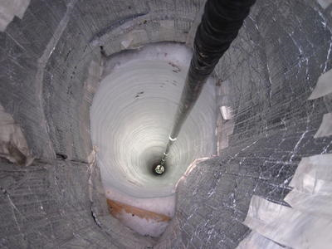
IceCube
Much the largest existing detector, instrumenting 1 km³ of Antarctic ice. Precursor, AMANDA II, very similar to ANTARES in size and sensitivity.

Slide 13
Medium Properties
Property | Lake Baikal | Mediterranean (ANTARES) | Antarctic ice
Absorption length (m) | 20−24 | 50−70 (blue) | ~100
Scattering length (m) | 30−70 | 230−300 (blue) | ~20
Depth | 1370 | 2475 | 2450
Noise | Quiet | ⁴⁰K, bioluminescence | Quiet
Retrieve/ redeploy | Yes | Yes | No
Long scattering length for ANTARES implies better angular resolution; long absorption length for IceCube implies sparser instrumentation.
Quiet environments imply potentially useful data from singles rates.

Slide 14
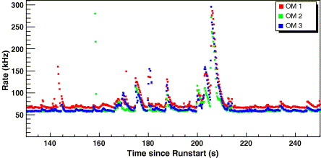
Background in Antares
Three components
steady background of ~60 kHz from ⁴⁰K
slowly varying contribution from bioluminescence, probably bacterial
short bursts of strong bioluminescence, probably from larger organisms
Correlated within a single storey, but not over long distances
minimal influence on tracking efficiency
does probably preclude use of singles rate, e.g. for detection of low energy neutrinos from supernova

Slide 15
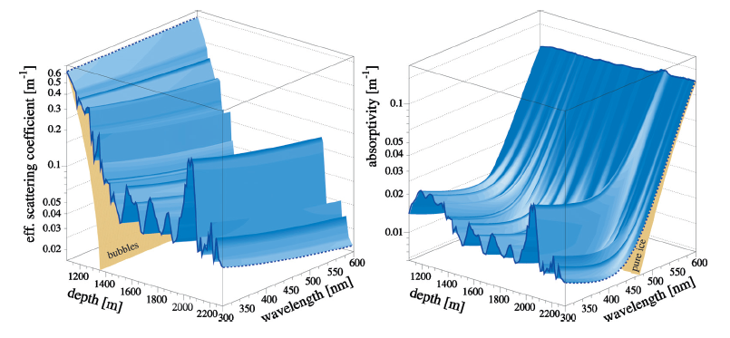
Light Transmission in IceCube
Scattering is a consequence of dust layers in the ice—function of global climate, level of volcanic activity, etc. “Dust logger” measures reflected light from artificial light source just after drilling: measure scattering with few mm vertical resolution. Note additional contribution from bubbles at shallow depths (<1400 m); IceCube deployed below this level.

Slide 16
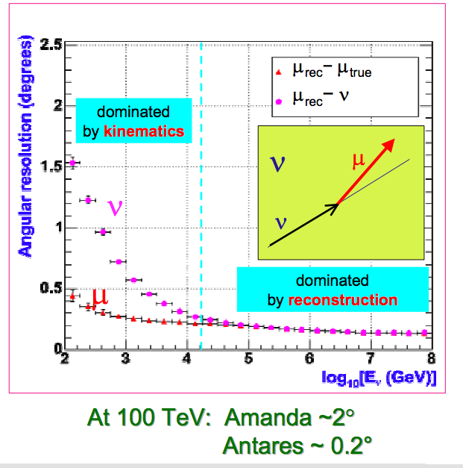
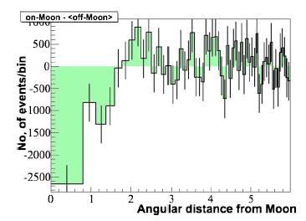
Angular Resolution
Moon’s shadow in CR muons, measured by IceCube
Expected IceCube angular resolution ~0.5°

Slide 17
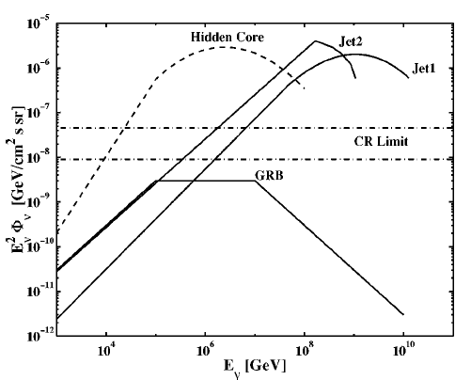
Expected Fluxes
Expect high-energy astrophysical neutrinos to be produced in proton interaction cascades
therefore, observed CR flux implies upper bound on neutrino flux (Waxman- Bahcall bound: Phys. Rev. D59 (1998) 023002)
argument goes as follows:
from observed CR rate, deduce that the amount of energy emitted by astrophysical sources in the form of UHE CRs (10¹⁹ – 10²¹ eV) is of order 10³⁷ J Mpc⁻³ yr⁻¹.
assume that CRs lose some fraction ε of their energy through pion photoproduction before escaping the source
fraction of proton energy carried by neutrino produced in this way is about 5% independent of proton energy, so neutrino energy spectrum follows scaled-down version of proton spectrum
resulting bound is E_{ν}²φ_{ν} < 2×10⁻⁸ GeV cm⁻² s⁻¹ sr⁻¹ for 10¹⁴−10¹⁶ eV ν

Slide 18

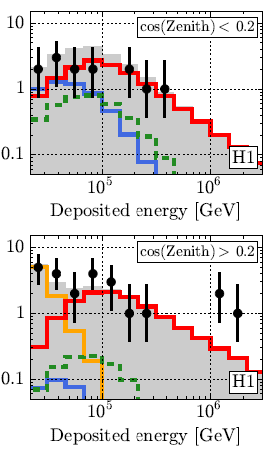
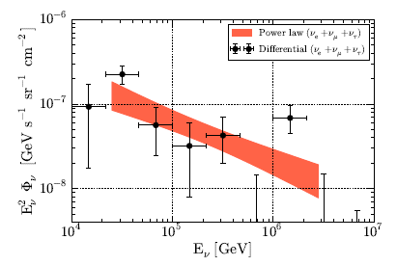
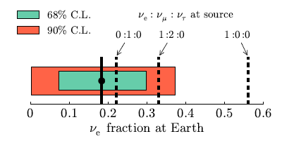
Results
For 3 years of data-taking: 37 events above 100 TeV, on background of about 15
Flux at 100 TeV: (6.7±1.2)×10⁻¹⁸ GeV⁻¹ s⁻¹ sr⁻¹ cm⁻²
Spectral index 2.50±0.09
No significant point sources or correlations with other data

Slide 19
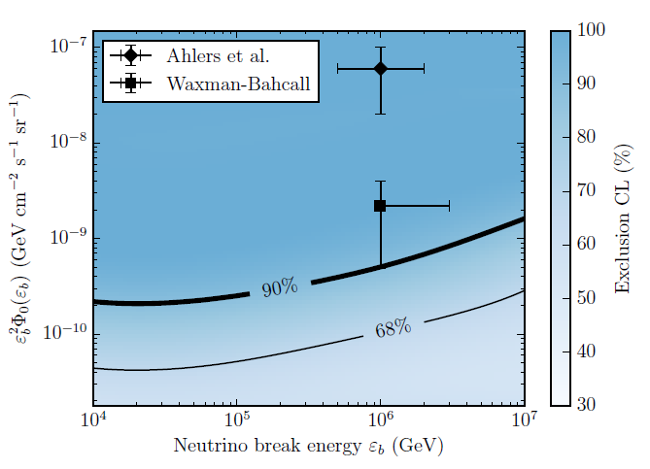
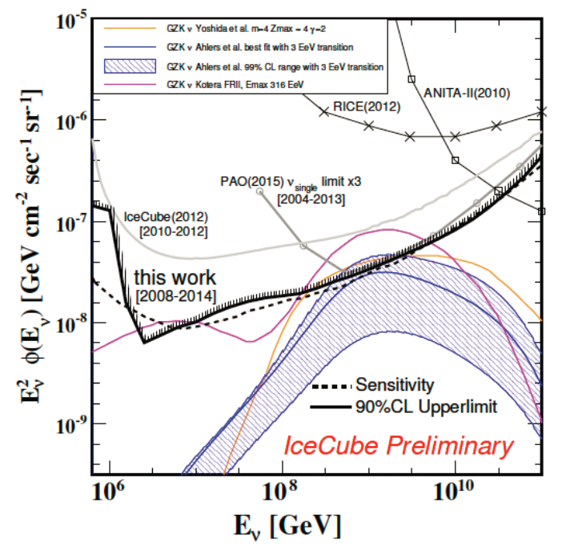
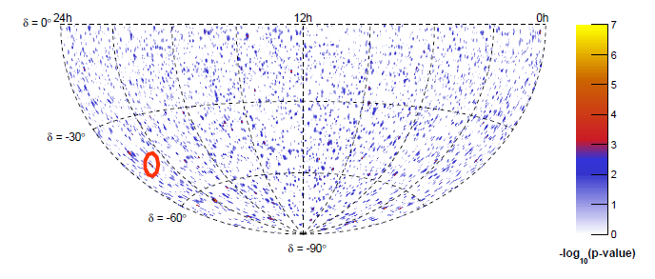
Results
No neutrinos from GRBs
No GZK neutrinos
No point sources (combined IceCube/ANTARES analysis: largest significance 0.7σ)

Slide 20
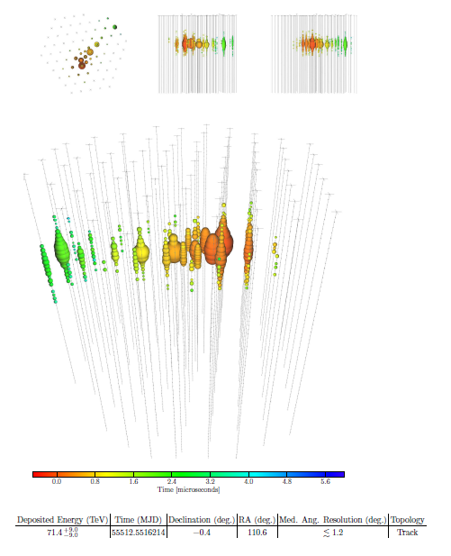
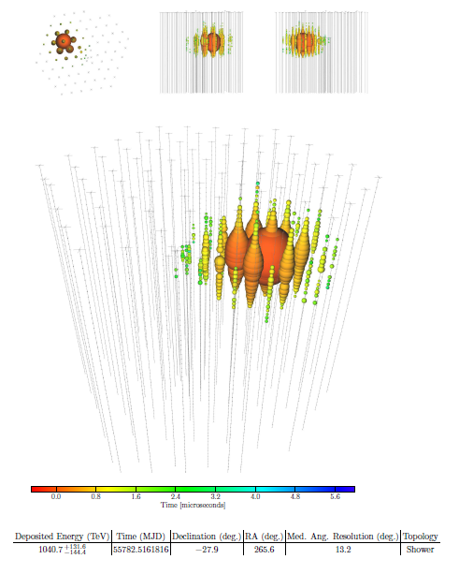
Example IceCube events

Slide 21
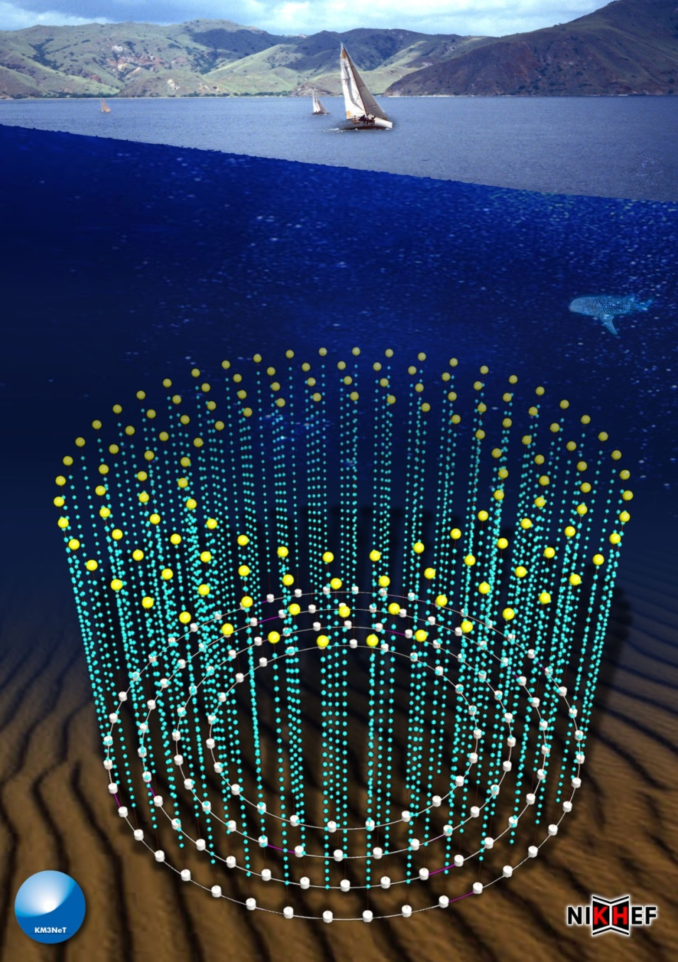
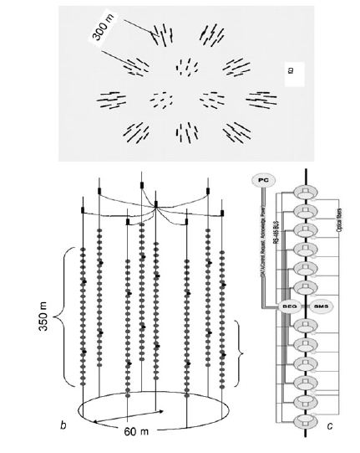
Next Generation Water Cherenkovs
Baikal-1000
KM3NeT Design Study
IceCube-sized detector in Mediterranean, with much better angular resolution (0.07° @ 100 TeV)

Slide 22
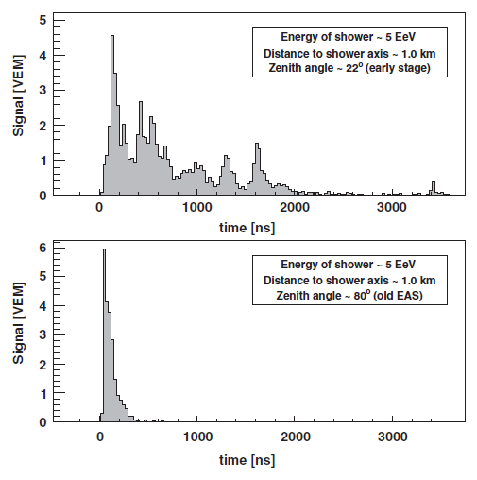
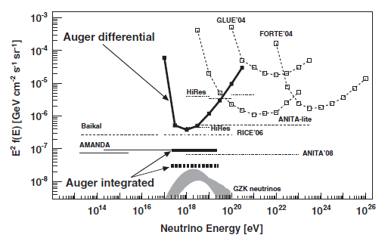
Tau-Neutrino Detection By Air Showers
Earth-skimming ν_{τ} interacts in Earth’s crust to produce τ
τ decay in atmosphere initiates characteristic air shower
shower appears to be in early stage of development—typical horizontal shower is “old”
searched for by Auger—no signal (PRD 79 (2009) 102001)

Slide 23
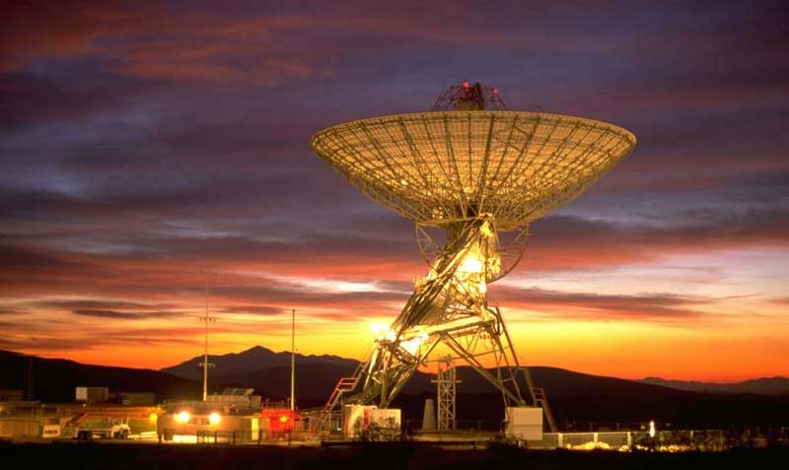
High Energy Astroparticle Physics
New Detection Techniques

Slide 24
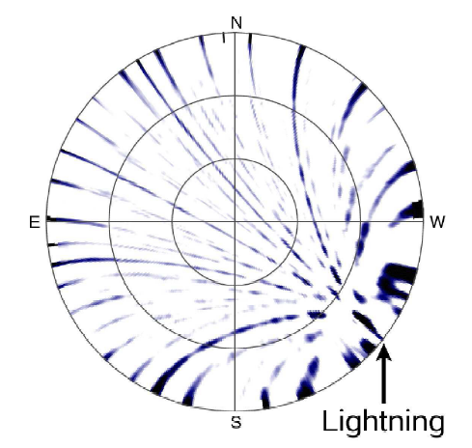
Radio-Frequency Detection of Air Showers and Neutrinos
Geosynchrotron emission (10−100 MHz)
synchrotron radiation from air-shower particles gyrating in Earth’s magnetic field
advantages over fluorescence:
very high duty cycle (only wiped out by thunderstorms)
low attenuation (so, large effective area)
disadvantages:
interference (need radio-quiet sites)
high threshold (10¹⁷ eV)
Radio Cherenkov (Askaryan effect) (0.1−2 GHz)
Cherenkov emission from neutrino-induced showers because of net negative charge
initially neutral shower develops ~20% negative bias because of annihilation of e⁺ and additional e⁻ from Compton scattering etc.
requires dense, radio-transparent medium
not air, not water

Slide 25
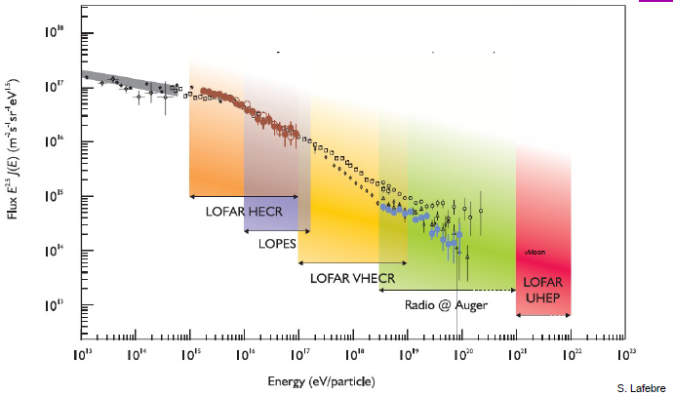
Geosynchrotron Emission
Studies run in association with Auger and KASCADE CR ground arrays
A declared key science goal of LOFAR Collaboration

Slide 26
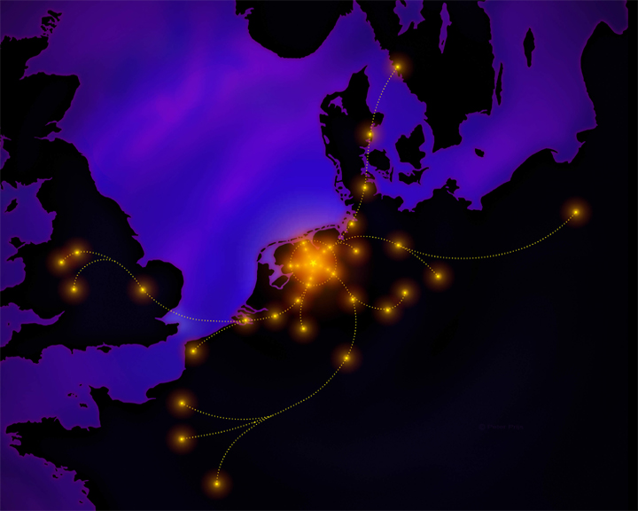
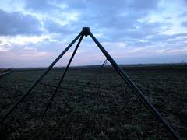
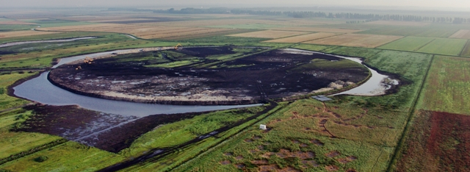
LOFAR
Low frequency radio array based in the Netherlands
Mostly a radio astronomy facility, but good prospects for radio detection of UHECRs (see LOPES/KASCADE).
Also good for gravitational wave follow-up (excellent wide-field coverage)

Slide 27
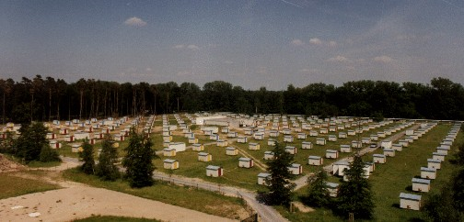
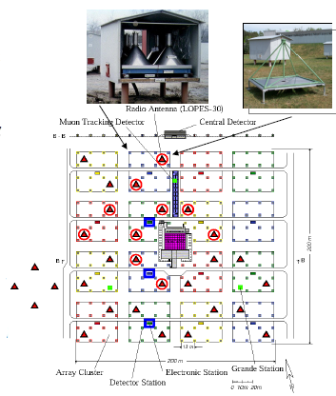
LOPES/KASCADE
KASCADE: scintillator-based ground array
LOPES (LOFAR PrototypE Station)
initially 10, now 30, low-frequency RF antennas triggered by KASCADE “large event” trigger
KASCADE reconstruction provides input to LOPES recon:
core position of air shower
its direction
its size

Slide 28



LOPES/KASCADE
First detection: January 2004
strong coherent radio signal coincident with KASCADE shower
reconstruction location agreed with KASCADE to 0.5°
Extensive data sample now accrued
technique works well and suggests full LOFAR array should be excellent CR detector

Slide 29

LOFAR as a cosmic ray detector
Small scintillator-based air-shower array (LORA) set up in LOFAR core
plastic scintillator detectors from KASCADE, set up in 5 sets of 4
estimated energy resolution ~30%, angular resolution ~1%
combined running with LOFAR
Thoudam et al., astro-ph/1102.0946v1

Slide 30



Auger/AERA
Preliminary studies using a few radio antennas at the Auger site gave promising results
Plan to instrument 20 km² near Coihueco fluorescence telescope with 160 autonomous self-triggering radio antennas
5000 events/year expected, 1000 above 10¹⁸ eV
124 stations deployed so far

Slide 31


Auger/AERA/AMIGA Event Detection
Shower depth determination by AERA and fluorescence
Event detected by all four Auger subdetectors

Slide 32


Askaryan Effect
Effect demonstrated in sand(2000), rock salt (2004) and ice (2006)
all done in laboratory at SLAC
Applications to neutrino detection
using the Moon as target
GLUE (detectors are Goldstone RTs)
NuMoon (Westerbork array; LOFAR)
RESUN (EVLA)
using ice as target
FORTE (satellite observing Greenland ice sheet)
RICE (co-deployed on AMANDA strings, viewing Antarctic ice)
ANITA (balloon-borne over Antarctica, viewing Antarctic ice)

Slide 33




Askaryan Effect: ANITA

Slide 34


Askaryan Effect
Jaeger et al., Astropart. Phys. 34 (2010) 293
ANITA observed UHECRs (geosynchrotron signal)
Nobody saw neutrinos (sadly)

Slide 35
Acoustic Detection (Showering Neutrinos)
UHE (>1 PeV) neutrinos interact fairly readily
on entering dense medium (water) they will initiate shower
this dumps energy in a thin cylinder (~20 m × 20 cm)
resulting pressure pulse spreads out from this cylinder in thin “pancake” perpendicular to incoming neutrino direction
produces characteristic bipolar acoustic pulse which can be detected by hydrophone array
advantages
extremely long attenuation length (several km)
very large volume can in principle be instrumented with relatively small number of hydrophones
hydrophone technology well established in underwater applications
can use off-the-shelf hardware
disadvantages
the sea is a very noisy place
identifying signal very challenging

Slide 36

Principles

Slide 37
Experiments
ACORNE
UK feasibility study using military hydrophone array off Rona
AMADEUS
codeployed with ANTARES
Lake Baikal
codeployed with Baikal-200
ONDE
part of NEMO (NEutrino Mediterranean Observatory, not Neutrino Ettore Majorana Observatory!)
SAUND-I and SAUND-II
in Bahamas, originally using military array, now extended
SPATS
at South Pole, associated with IceCube

Slide 38


ACORNE
MoD hydrophone array off NW coast of Scotland
successful R&D project showing feasibility of technique
array geometry not optimal (not designed for neutrinos!)
Example of background source—dolphin clicks!

Slide 39



AMADEUS
Acoustic storeys added to ANTARES strings
R&D project comparing different hydrophones
feasibility study for KM3NeT

Slide 40



SPATS
Acoustic sensors on strings deployed in association with IceCube
very good at detecting IceCube drilling and water storage activities!

Slide 41

Acoustic Detection: Summary
Experiments so far are R&D projects/feasibility studies
limits not competitive with radio at present
Future strategy mostly co-deployment with large optical Cherenkovs
improves high-energy sensitivity
likely future direction: super-hybrid experiments with optical Cherenkov, acoustic and radio elements, plus air-shower array if appropriate
most nearly realised at South Pole with IceCube/IceTop/RICE/SPATS

Slide 42
Neutrino Detection: Summary
High-energy neutrinos could provide information on
acceleration processes in high-energy astrophysics
GZK cut-off in cosmic rays
dark matter (see next lecture)
Detection still in infancy
only IceCube probably large enough to collect statistics
Various promising techniques
water Cherenkov at lower energies
radio and possibly acoustic at high end
Hybrid experiments feasible at many sites

