Slide 1

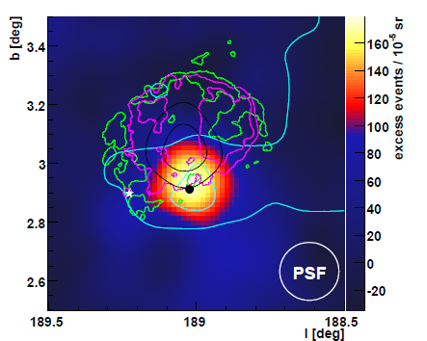
ASTROPARTICLE PHYSICS LECTURE 2
Susan Cartwright
University of Sheffield

Slide 2
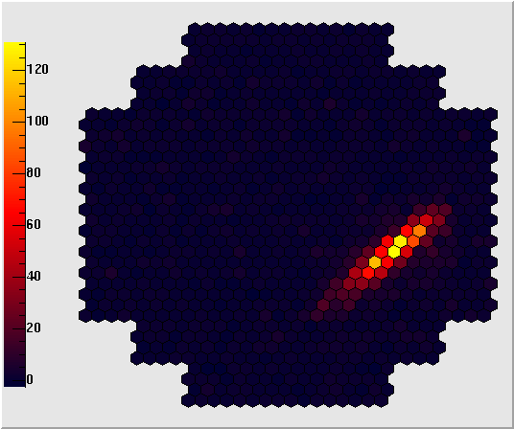
High Energy Astroparticle Physics
Acceleration Mechanisms
Sources
Detection

Slide 3
Detection of High Energy Astroparticles
Basic principles
  Cosmic rays and high-energy γs shower in the atmosphere
    detect light emitted or induced by the shower
      Cherenkov radiation
      fluorescence
    detect shower particles that reach the ground
      much more likely for hadron-induced showers
  Neutrinos in general don’t shower
    detect products of charged-current interactions (e, μ, τ)
  Ultra-high-energy neutrinos will shower in matter
    acoustic detection of shower energy

Slide 4
Detection of Air Showers
Cherenkov radiation
  emitted by charged particles in the shower travelling at speeds > c/n where n is refractive index
    forward peaked
    faint, so requires dark skies
    relatively low energy threshold
    works for both hadron and photon cascades—basis of ground-based γ-ray astronomy
Nitrogen fluorescence
  UV radiation emitted by excited nitrogen molecules
    isotropic
    requires dark skies
Detection of shower particles on ground
  usually using water Cherenkov detectors
    higher threshold
    not dependent on sky conditions
    works better for hadron-induced showers

Slide 5

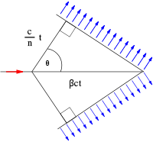

Cherenkov Radiation
Radiation emitted by charged particle travelling faster than speed of light in a medium
  wavefronts constructively interfere to produce cone of radiation
    angle of cone given by
    cos θ = 1/βn
    for astroparticle
    applications usually
    β ≈ 1
    hence in air θ ≈ 1.3°
    (depends on temperature);
    in water θ ≈ 41° (40° for ice)

Slide 6
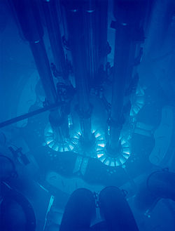
Cherenkov Radiation
Spectrum of radiation is given by Frank-Tamm formula
  μ is permeability of medium, n its refractive index, q charge of particle, β its speed, ω emitted angular frequency, x length traversed
    note that dE ∝ ω; spectrum is continuous, but
    in general radiation is most intense at
    high frequencies
Threshold given by β > 1/n
  below this no Cherenkov radiation
  emitted
    basis of “threshold Cerenkov counters” used
    for particle ID in particle physics experiments

Slide 7
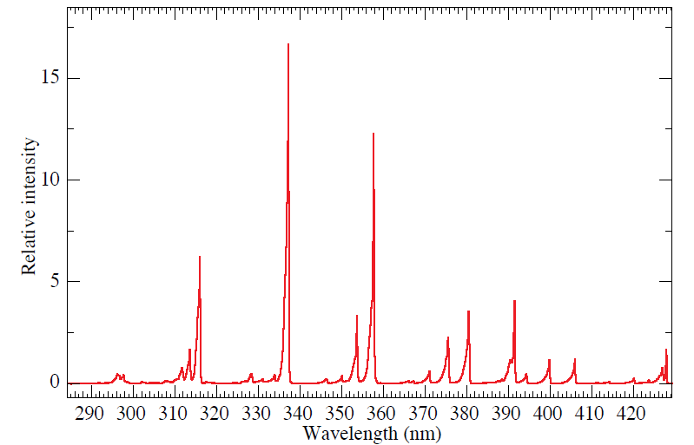
Fluorescence
M. Ave et al., [AIRFLY Collab.], Astropart. Phys. 28 (2007) 41.
Misnamed!
  it’s really scintillation
Emitted isotropically
  in contrast to Cherenkov
Almost independent of
primary particle species
  exciting particles are mainly e± which are produced by both electromagnetic and hadronic cascades
  light produced ∝ energy deposited in atmosphere
Emitted light is in discrete lines in near UV
  detection requires clear skies and nearly moonless nights
Fluorescence spectrum excited by 3 MeV electrons in dry air

Slide 8
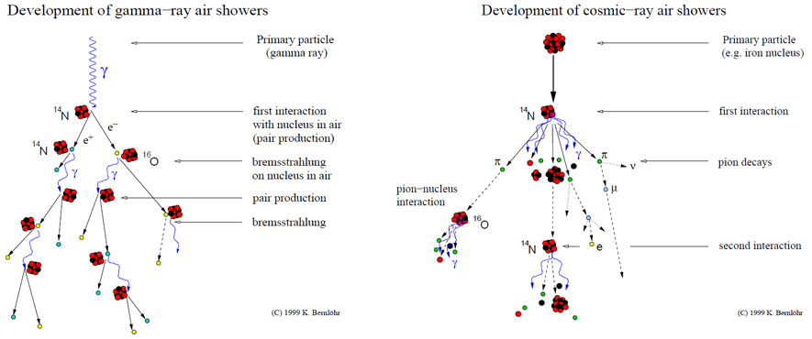
Schematic of Air-Shower Development
Gamma-induced showers have different particle content and will peak at a different height from hadron-induced showers. They also have a different morphology—note the subshowers in the hadron-induced cascade.

Slide 9
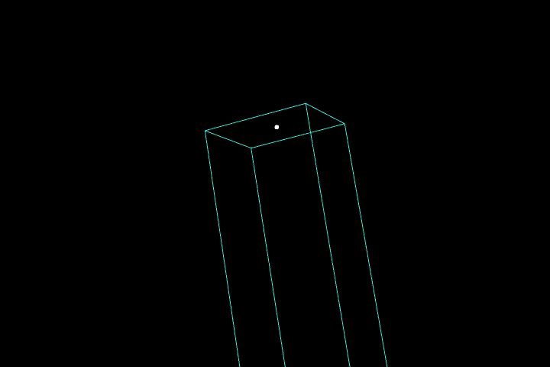
Air Shower Animation
http://astro.uchicago.edu/cosmus/projects/aires
Ave, Surendran, Yamamoto, Landsberg, SubbaRao (animation); Sciutto (AIRES simulation)

Slide 10
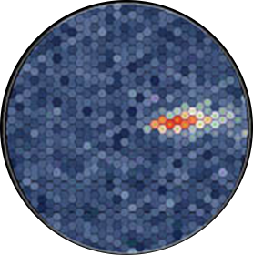
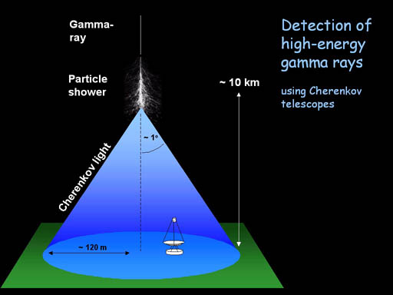
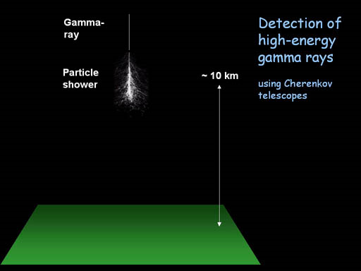

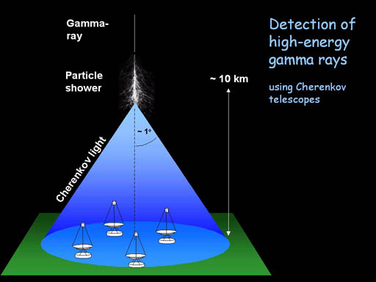
TeV Gamma-Ray Astronomy:
Imaging Atmospheric Cherenkov Telescopes
Principles (from H.E.S.S. website)

Slide 11
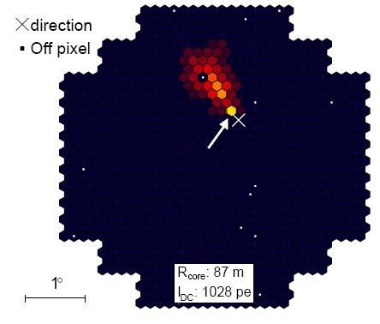
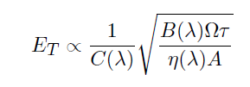
TeV Gamma-Ray Astronomy:
Imaging Atmospheric Cherenkov Telescopes
Particle identification
  shower shape
    broader and less regular for
    hadron-induced showers
    narrow cone of direct emission
    from heavy nucleus
Energy reconstruction
  total Cherenkov light yield
  ∝ energy of primary
    resolution typically 15-20%
    threshold given by
    where C is Cherenkov yield, B sky background,
    η photon collection efficiency, A mirror area, Ω solid angle, τ integration time
direct Cherenkov emission from primary
Heavy nucleus signal in HESS

Slide 12
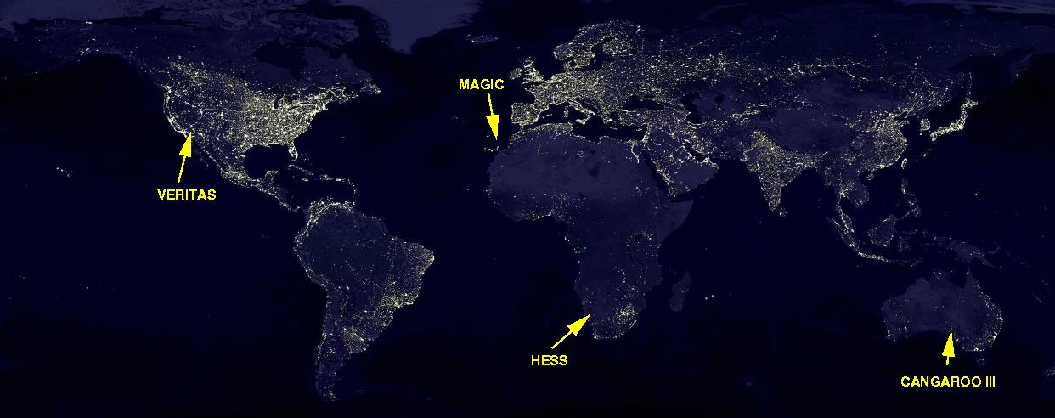
TeV Gamma-ray Observatories
Yakutsk
MILAGRO
STACEE
Tibet AS-Gamma
PACT
Main sites: VERITAS, HESS, CANGAROO III (stereo systems); MAGIC (single dish)
two since 2009

Slide 13
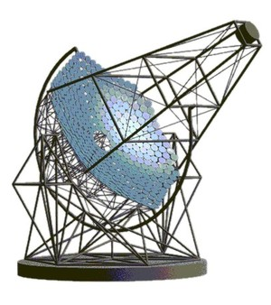
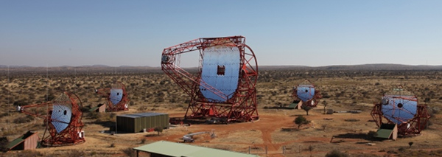
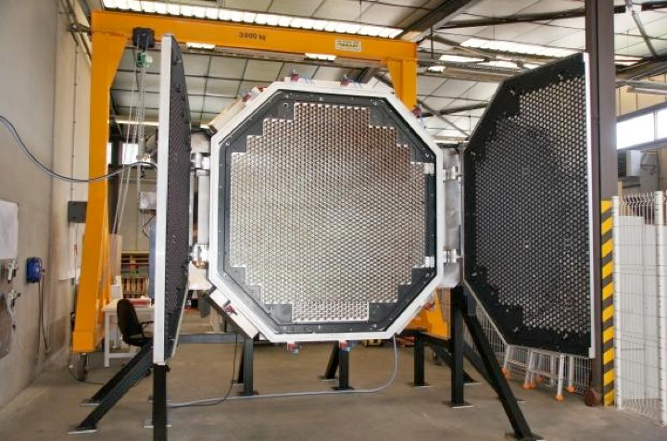
IACT Technology: H.E.S.S. (Namibia)
4 telescopes each of 108 m² aperture
Camera array of 2048 pixels (0.07°)
New 28-m telescope operational since 2012 (should reduce energy threshold to 30 GeV)

Slide 14
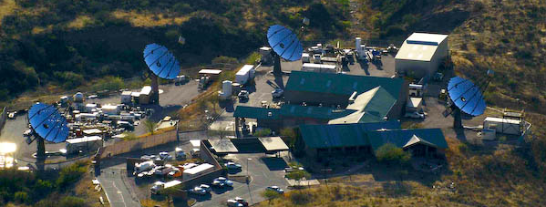
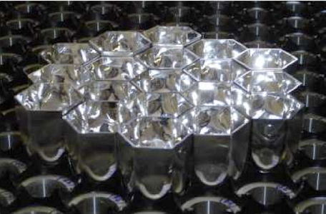
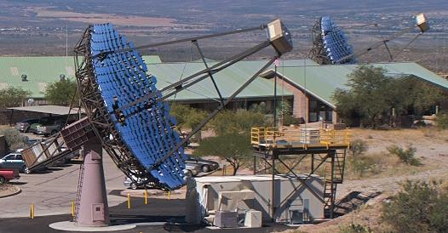
IACT Technology: VERITAS (USA)
Very similar to H.E.S.S. I
4 telescopes each 110 m²
499-pixel camera

Slide 15
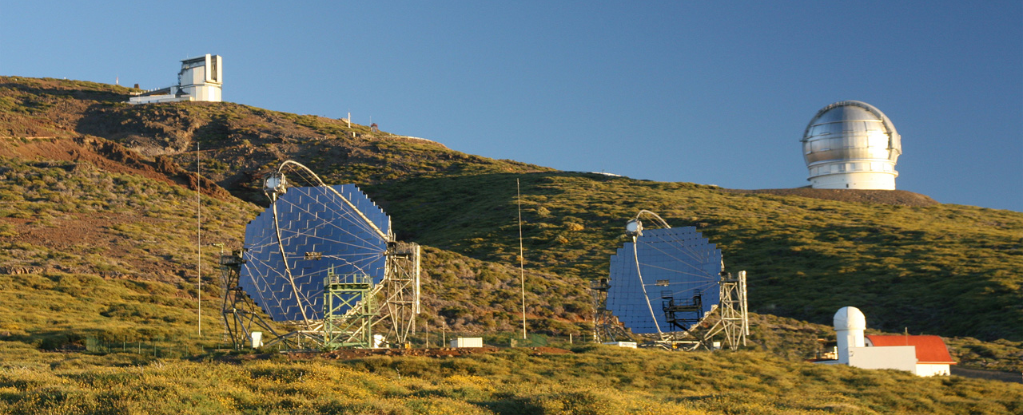
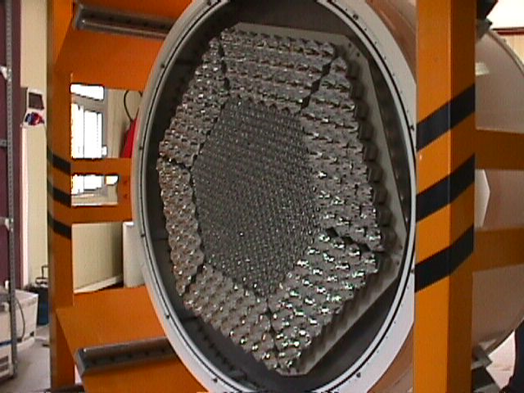
IACT Technology: MAGIC (Canary Islands)
Larger telescopes (236 m²), hence lower threshold; also fast slew to respond to GRB alerts
The two telescopes can operate independently
Camera has inner core of 396 1” PMTs,
outer ring of 180 1.5"

Slide 16
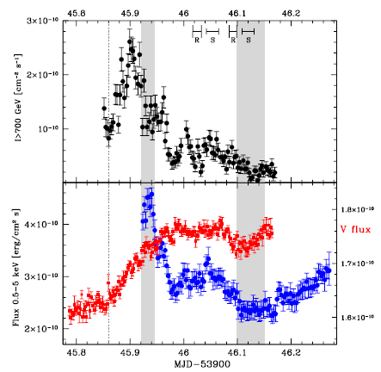
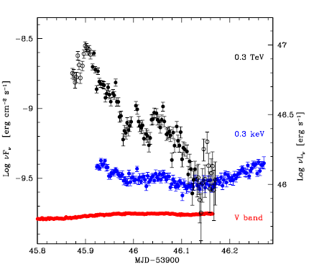
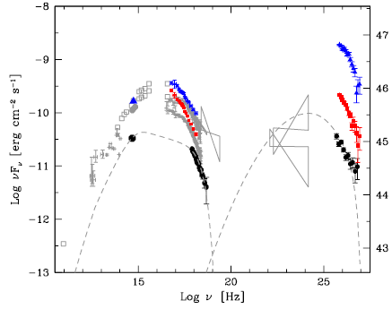
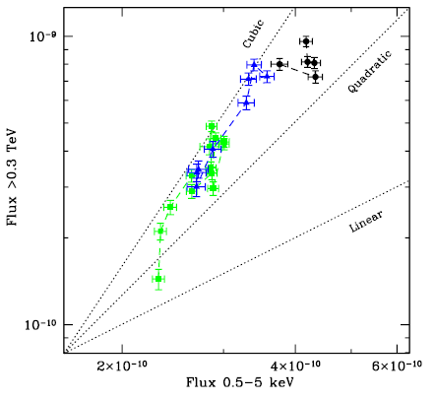
Some Results
Some blazar sources seen to
vary on very short timescales
(few minutes)
  plots show PKS 2155−304
  observed by HESS and Chandra
  (Aharonian et al., A&A 502 (2009) 749)
  flare is much larger at TeV energies
  but TeV & x-rays correlated
  explaining
  these fast
  flares is a
  major
  challenge
  for models

Slide 17
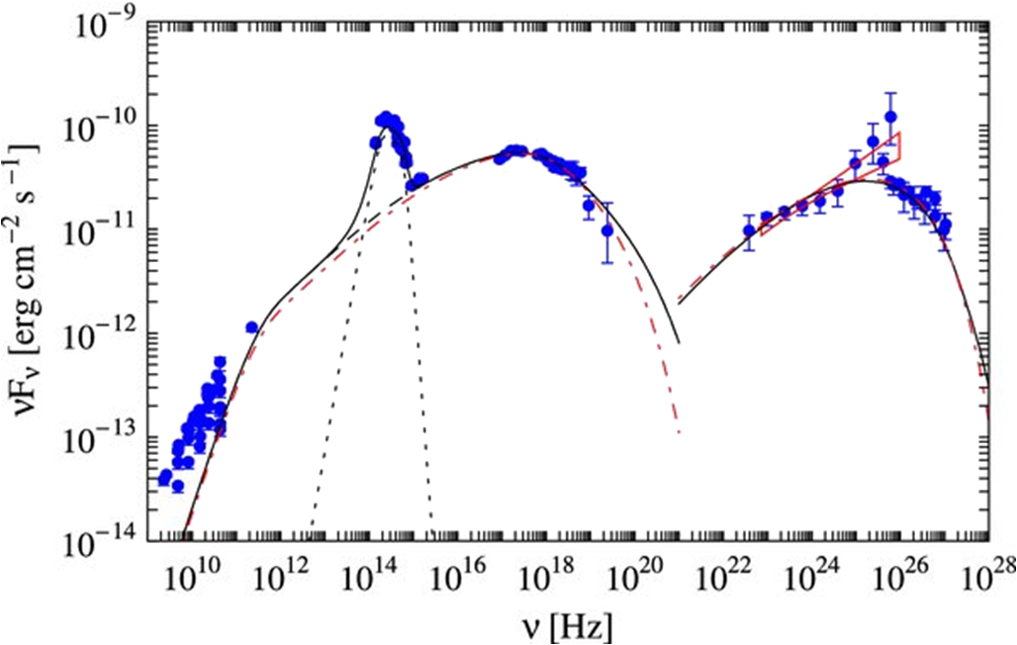
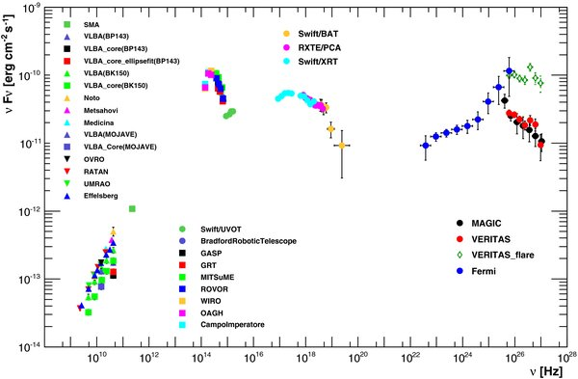
Some Results
Multiwavelength
study of Mkn 501
(Abdo et al, ApJ 727
(2011) 129)
  Note TeV flare
  see by VERITAS
Modelled by
one-zone SSC
  Fit parameters:
  jet Doppler factor δ, emitting region radius R, magnetic field B, ratio of electron and magnetic field comoving energy densities η, plus electron spectral distribution (modelled as broken power law in γ_{e} with exponential cut-off at high energies)
  find δ = 12, R = 1.3×10¹² km (9 AU), B = 0.015 G, η = 56, ⟨γ_{e}⟩ = 2400
    ultrarelativistic electrons in near-equipartition with mildly relativistic protons?
    consistent with shock acceleration

Slide 18
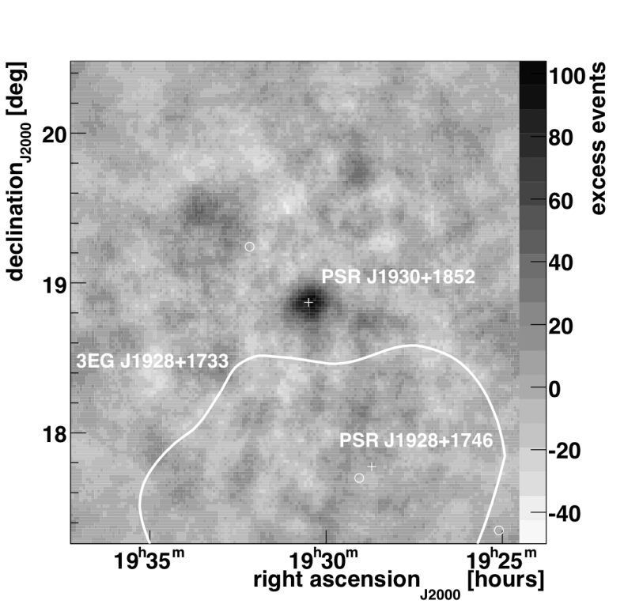
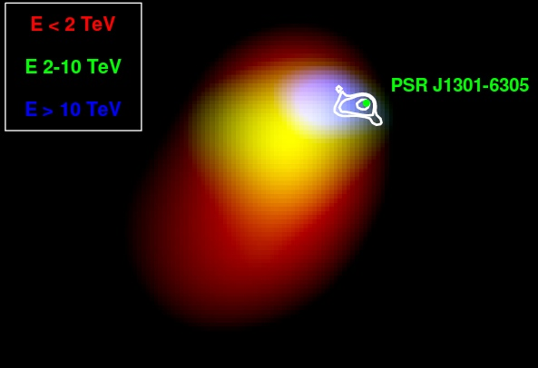
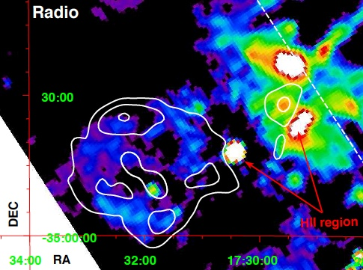
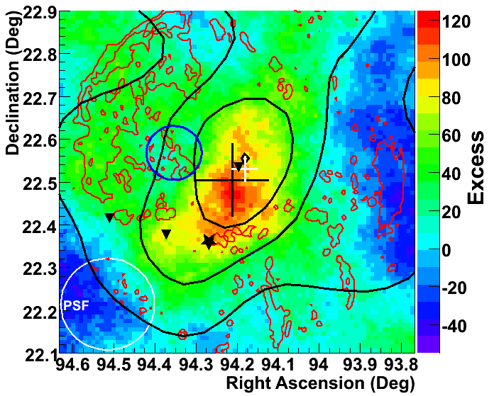
Some Results
VERITAS
Recent images of TeV sources associated with pulsars and SNRs
HESS J1303−631
+ HESS contours
HESS J1731−347
VERITAS SNR IC443
optical
CO
Fermi 95%
MAGIC (white +)

Slide 19
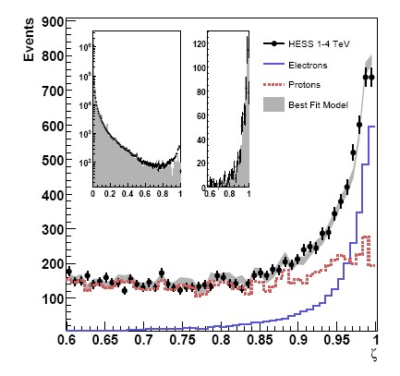
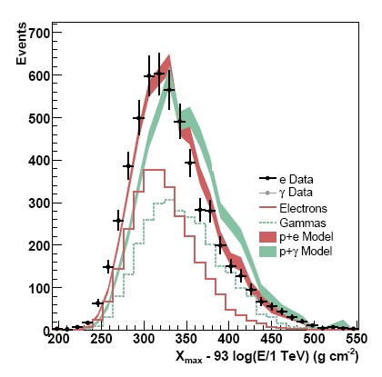
HESS as a detector of cosmic-ray electrons
Separation of electron and proton showers using multivariate analysis
Separation of electron and photon showers using X_{max} (depth of shower maximum): electrons
shower earlier than photons

Slide 20
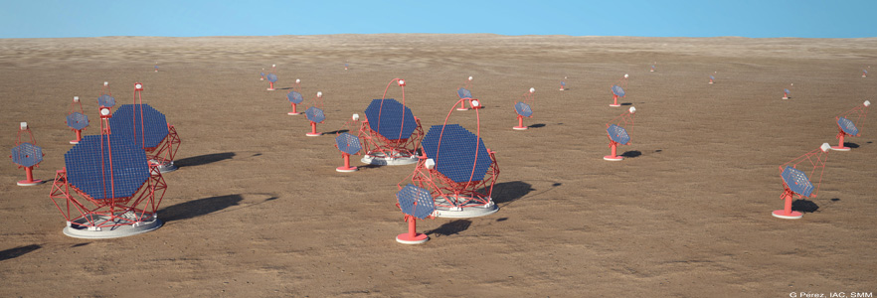

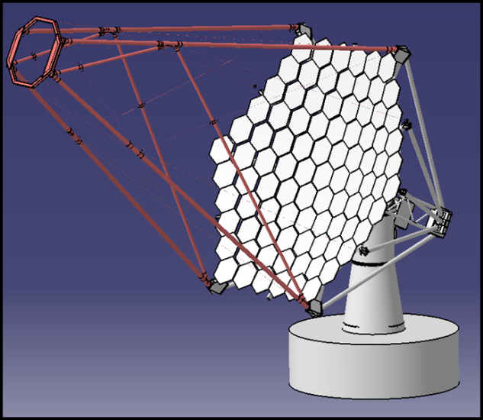
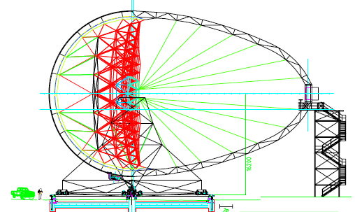
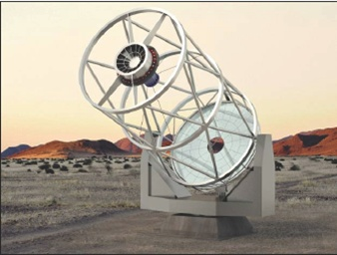
Future facility for TeV gamma-ray astronomy
  three different telescope designs optimised for different energies
  in design phase

Slide 21
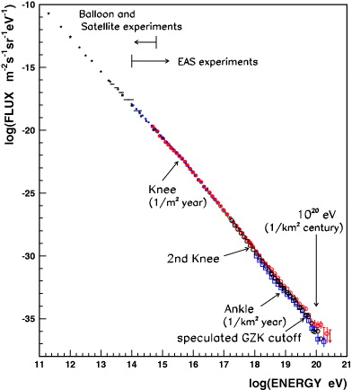
Cosmic Ray Detectors
Nagano, New J. Phys. 11 (2009) 065012
Focus in recent years on UHE CRs
  rare, so require very large area
  detectors
    fluorescence detectors “see” large
    effective area, but have limited
    duty cycle
    ground-based shower sampling has
    good duty cycle, but requires
    genuinely large area coverage to have large effective area
Fly’s Eye
Auger
Hybrid
Fluorescence
Ground array
(after Nagano 2009)
Haverah Park

Slide 22
Ground Array Technology
Large area ground arrays consist of multiple small stations whose data are combined to reconstruct the shower
  detector technology scintillator (SUGAR, AGASA) or water Cherenkov (Haverah Park, Auger)
    some detectors (AGASA, Yakutsk) also include underground muon detectors
  individual detectors need to be robust and self-contained
Energy reconstruction by
  conversion from shower size
    estimated number of electrons, N_{e}, combined with muons, N_{μ}, for those experiments with muon detectors
  particle density at a given (large) distance from core
    smaller fluctuations, and less sensitive to primary particle type, than shower core

Slide 23
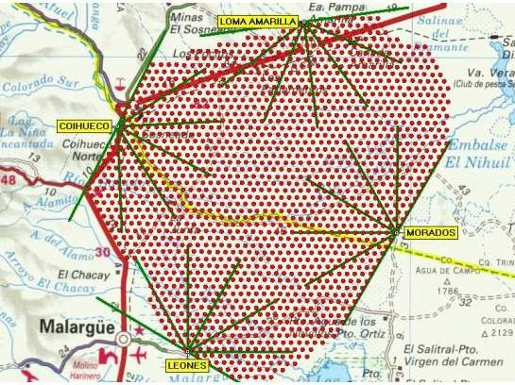
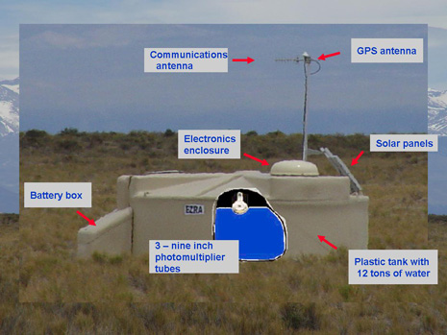
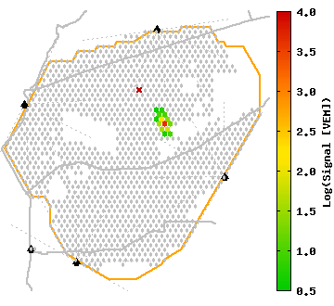
Example of Ground Array
Pierre Auger Observatory,
Argentina
  1600 water Cherenkov tanks
  solar powered with GPS
typical event display

Slide 24
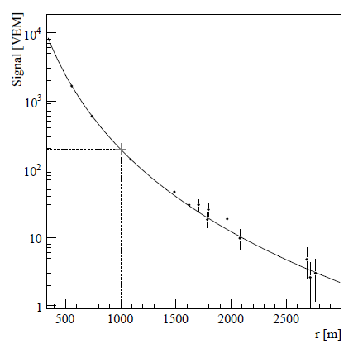
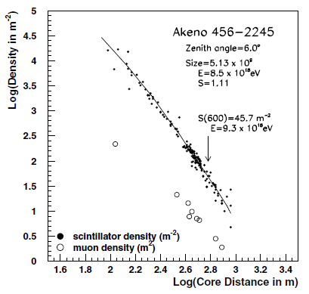
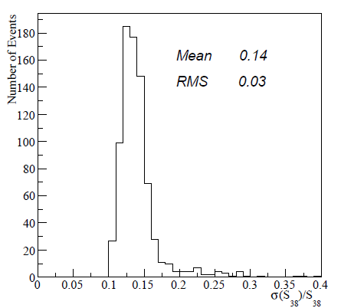
Energy Reconstruction in Ground Arrays
Auger fits S(1000), shower density 1 km from
core, and corrects for inclination to get S(38°)
  calibrated by comparison with fluorescence
AGASA used S(600), verified by comparison
with N_{e} and N_{μ}
Significant systematic errors (~20% quoted)

Slide 25
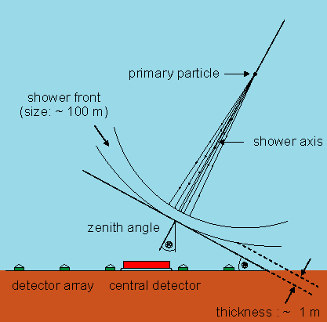
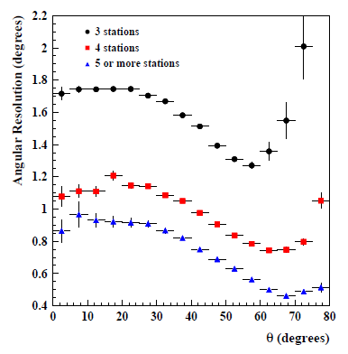
Direction Reconstruction in Ground Arrays
Direction is reconstructed
from arrival time of shower
at different ground stations
  better than 1° if >4 stations fire
  (E > 8 EeV)

Slide 26
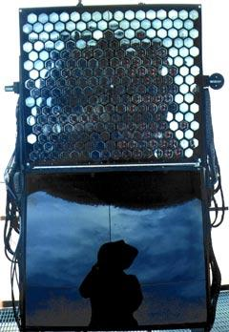
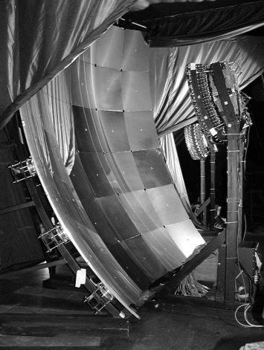
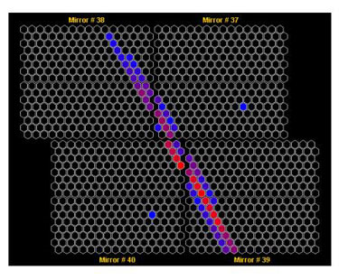

Fluorescence Detector Technology
Broadly similar to Cherenkov telescope
  Expect to see
  “stripe” of light
  corresponding to
  shower

Slide 27

Fluorescence Detector Technology
Auger fluorescence detector layout
Auger Coll., Nucl.Instrum.Meth. A620 (2010) 227

Slide 28

Background Rejection
Genuine event with colours showing time progression
Fake event probably caused by cosmic ray muon interacting directly in detector

Slide 29


Energy Reconstruction in Fluorescence Detector
Calorimetric detector: total light intensity measures electromagnetic energy in shower
  response calibrated using artificial
  light source and
  direct excitation
  of fluorescence
  with nitrogen
  laser
Auger Coll.

Slide 30


Energy Reconstruction in Fluorescence Detector
Measure longitudinal
shower profile
  Fit to standard
  profile (Gaisser-
  Hillas function)
  Correct for
  non-electromagnetic
  energy
    resulting statistical error is about 10%
    good agreement with ground array

Slide 31



Hybrid Detector Reconstruction
Combining detectors improves
performance
Angular resolution in hybrid mode 0.6°

Slide 32

Hybrid Event Schematic

Slide 33


Properties of Primary Cosmic Rays:
Particle Content
Particle identification by mean and variance of shower depth X_{max}
  At low energies similar to
  solar system, but enhanced
  in low Z spallation products
  at higher energy nearly pure
  protons
NASA
HiRes: Abbasi et al., ApJ 622 (2005) 910

Slide 34



Properties of Primary Cosmic Rays:
Particle Content
Some disagreement at highest energies!
Auger
HiRes

Slide 35

Energy Spectrum of UHECRs
E_{p} (eV)
Expect GZK cut-off at high energy
owing to pion photoproduction
via Δ resonance
  γ + p → Δ⁺ → p + π⁰ (or n + π⁺)
  requires E_{γ} = 145 MeV (150 MeV) for proton at rest
    energy of CMB photon ~3 k_{B} T = 7×10⁻⁴ eV on average
    so require proton γ ~2×10¹¹, i.e. E_{p} ~ 2×10²⁰ eV
    this is an overestimate, because protons will see high-energy tail of CMB blackbody—true cutoff is about 5×10¹⁹ eV
Result: protons with energies > 10²⁰ eV lose energy as they travel
  effective range of >GZK protons ~100 Mpc essentially independent of initial energy
distance (Mpc)

Slide 36

Observation of GZK Cutoff
Seen by both Auger and
HiRes
  apparent difference is
  consistent with
  systematic error in
  energy scale
This implies that sources
of UHECRs are genuinely
astrophysical objects
  local sources, e.g. decay of some kind of superheavy metastable dark matter, would not show cutoff

Slide 37

Combined CR Energy Spectrum
Energy scales adjusted based on pair-production dip just below 10¹⁹ eV.
Taken from Nagano (2009)

Slide 38


Cosmic Ray Anisotropy: Dipole
MILAGRO
Consistently observed by many experiments.
Probably caused by Sun’s orbital motion
IceCube

Slide 39


Cosmic Ray Anisotropy
MILAGRO
Small-scale anisotropy
Local source?
Magnetic field effect?
Heliotail?

Slide 40
Detection of UHE Gammas and CRs: Summary
UHE astroparticles are easier to detect from the ground than from space
  large detectors covering large effective areas are not easy to put into orbit
Cherenkov, fluorescence and ground-array technologies all well established
  each technique has advantages and disadvantages
  “hybrid” detectors using multiple techniques are effective
Multiwavelength studies of interesting objects provide increasingly good constraints on models
  relevant for TeV γ-rays, not for CRs because of lack of directionality

